Slide 1
résumés COMPUTERS LOVE
AND EMPLOYERS READ
ACDC 2016
Samantha Schellenberg, BA, RRP, CCDP – Owner, CHOICE WORKS Career Transitions
Facilitator, Designer, Trainer – Alberta Human Services

Slide 2
SESSION OBJECTIVES
Update knowledge on emerging résumé writing & résumé critiquing trends.
Increase understanding of challenges that online application systems have created for career development professionals and their clients.
Identify résumé writing & résumé critiquing Best Practices to remain professionally relevant in an intensely competitive job seeking market.
Notes:
SMALL GROUP – 20 MINS

Slide 3




EMERGING TRENDS

Slide 4
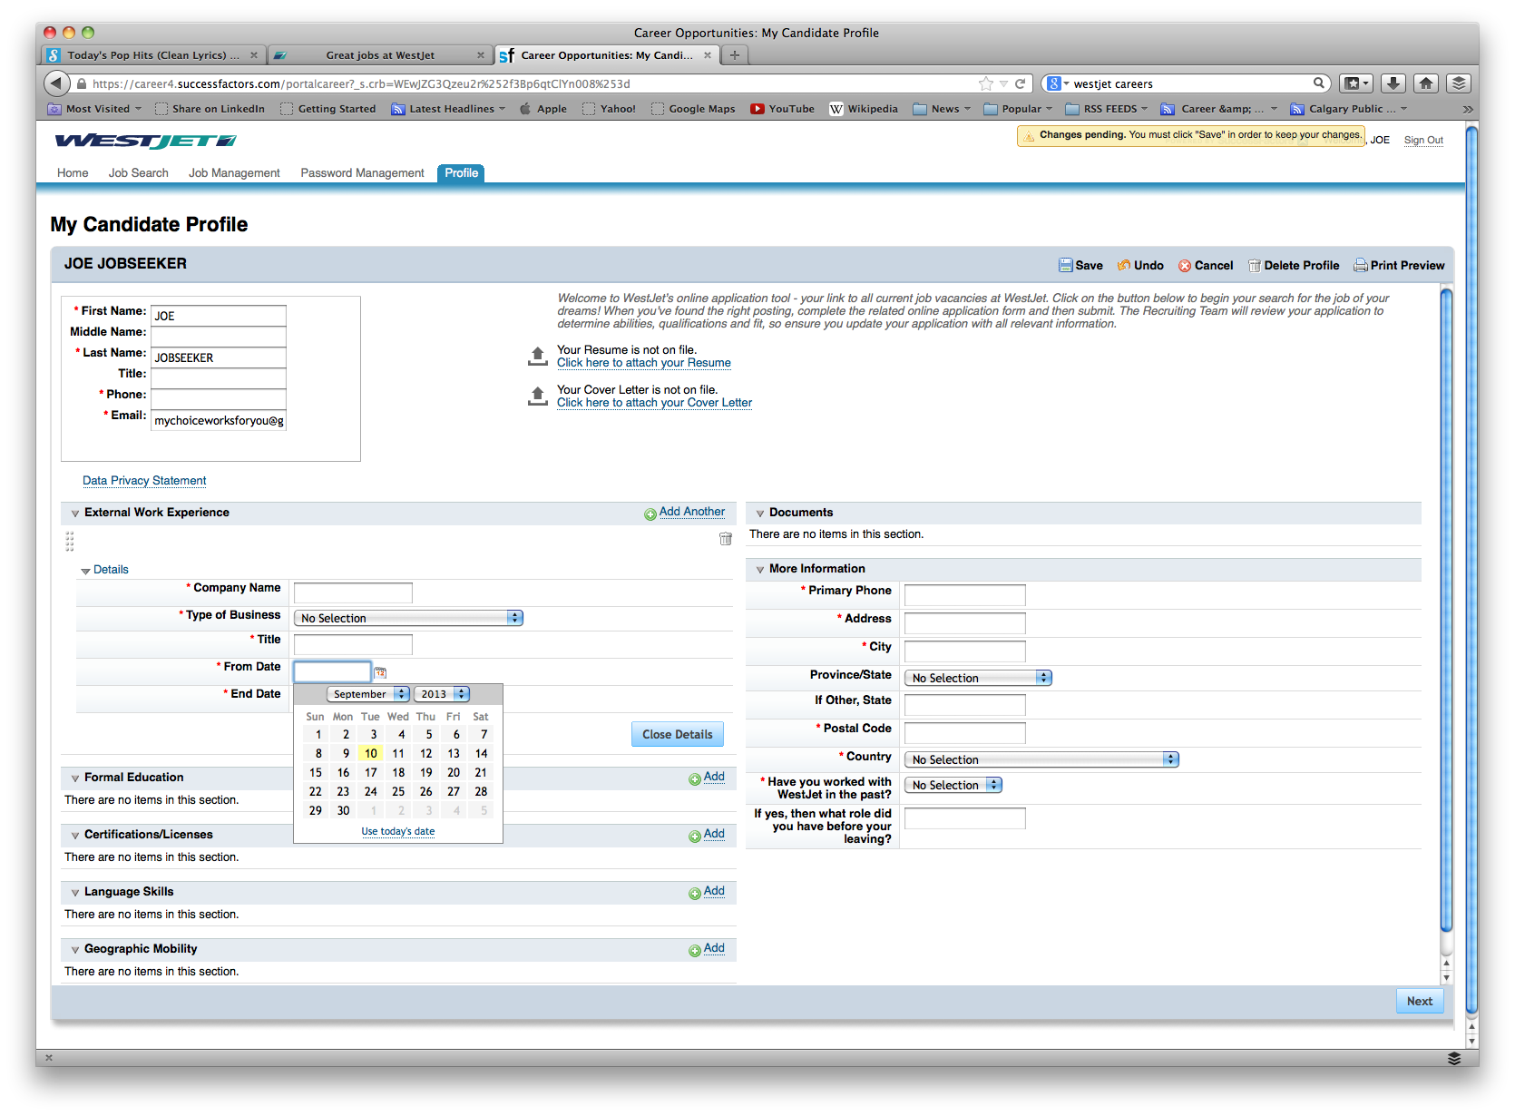
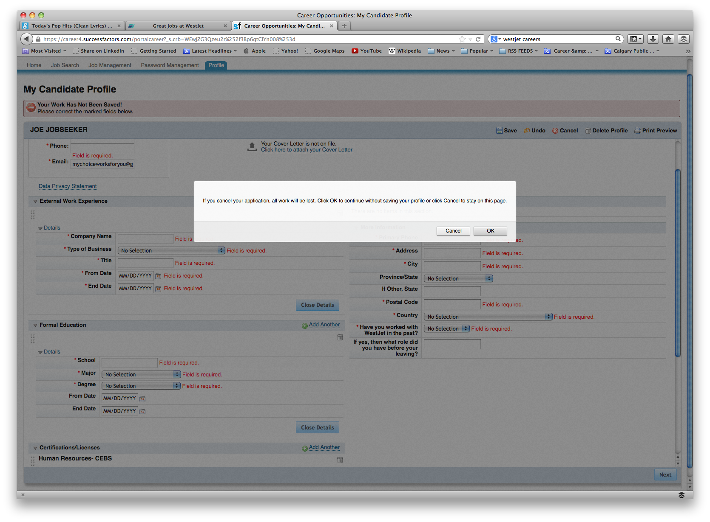
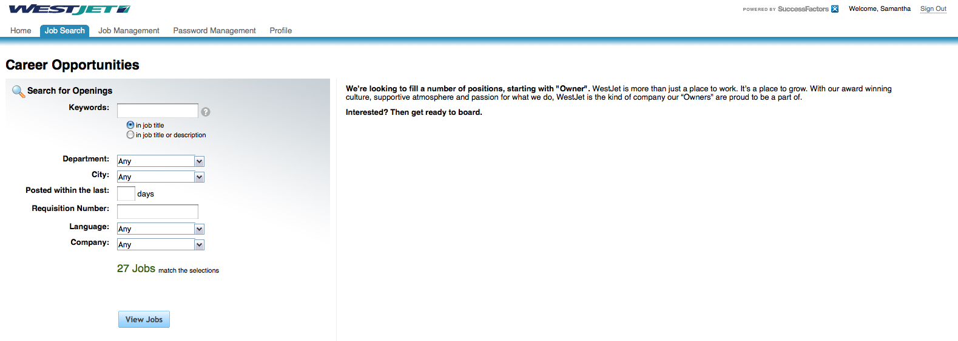
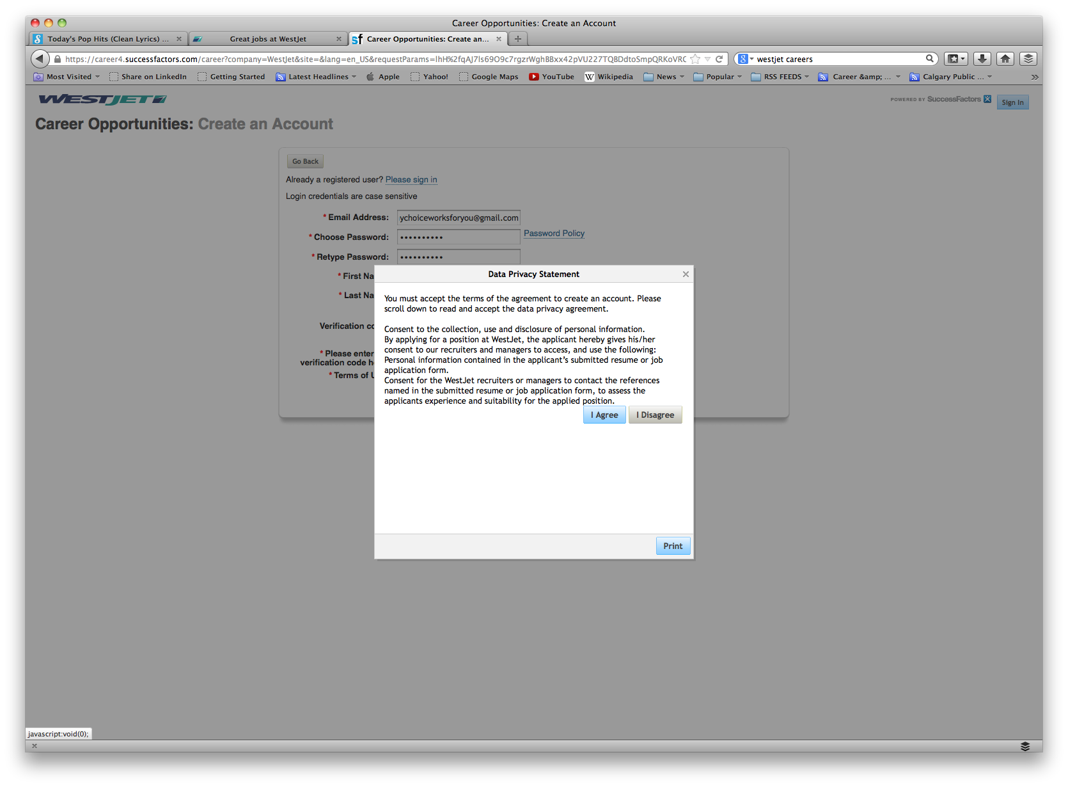
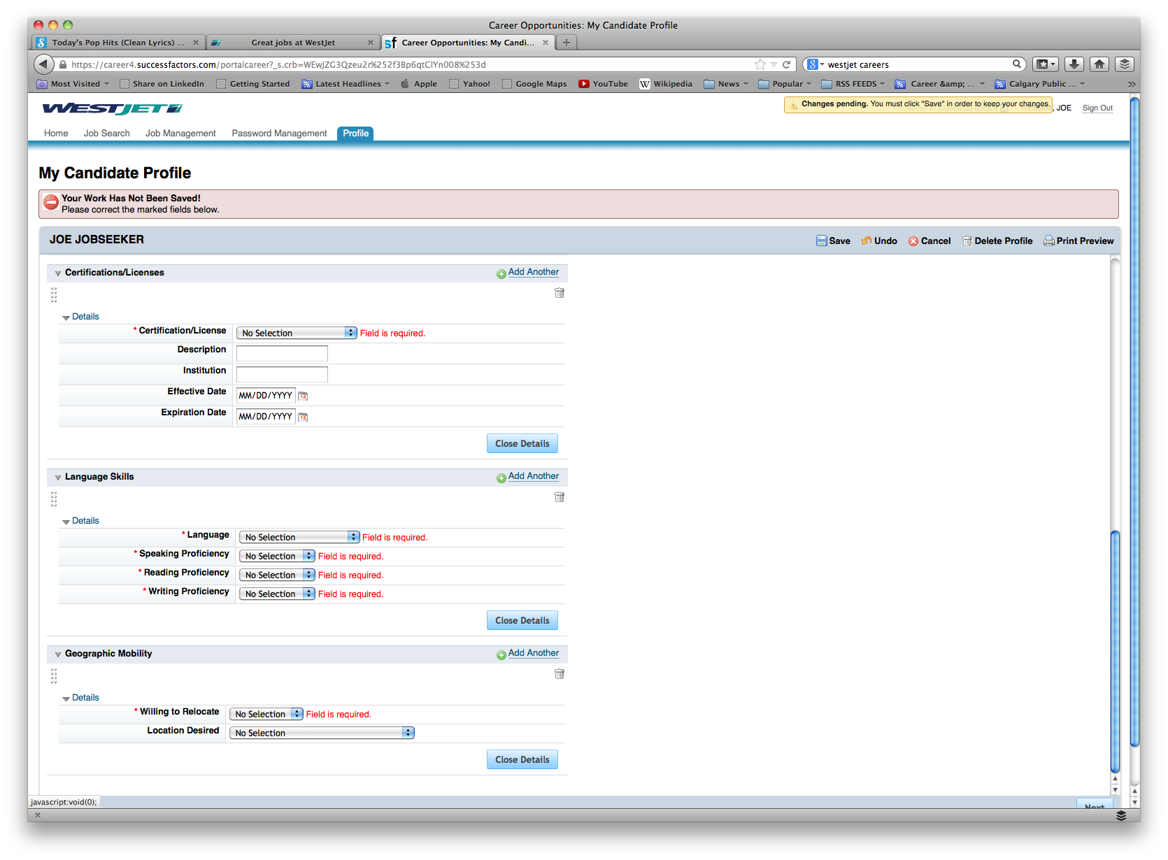
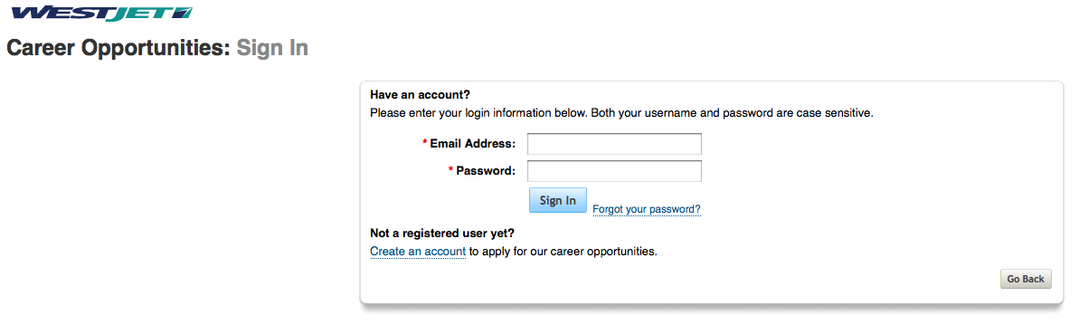
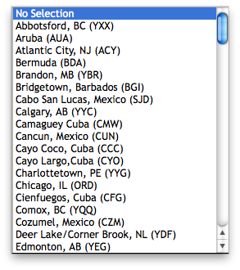

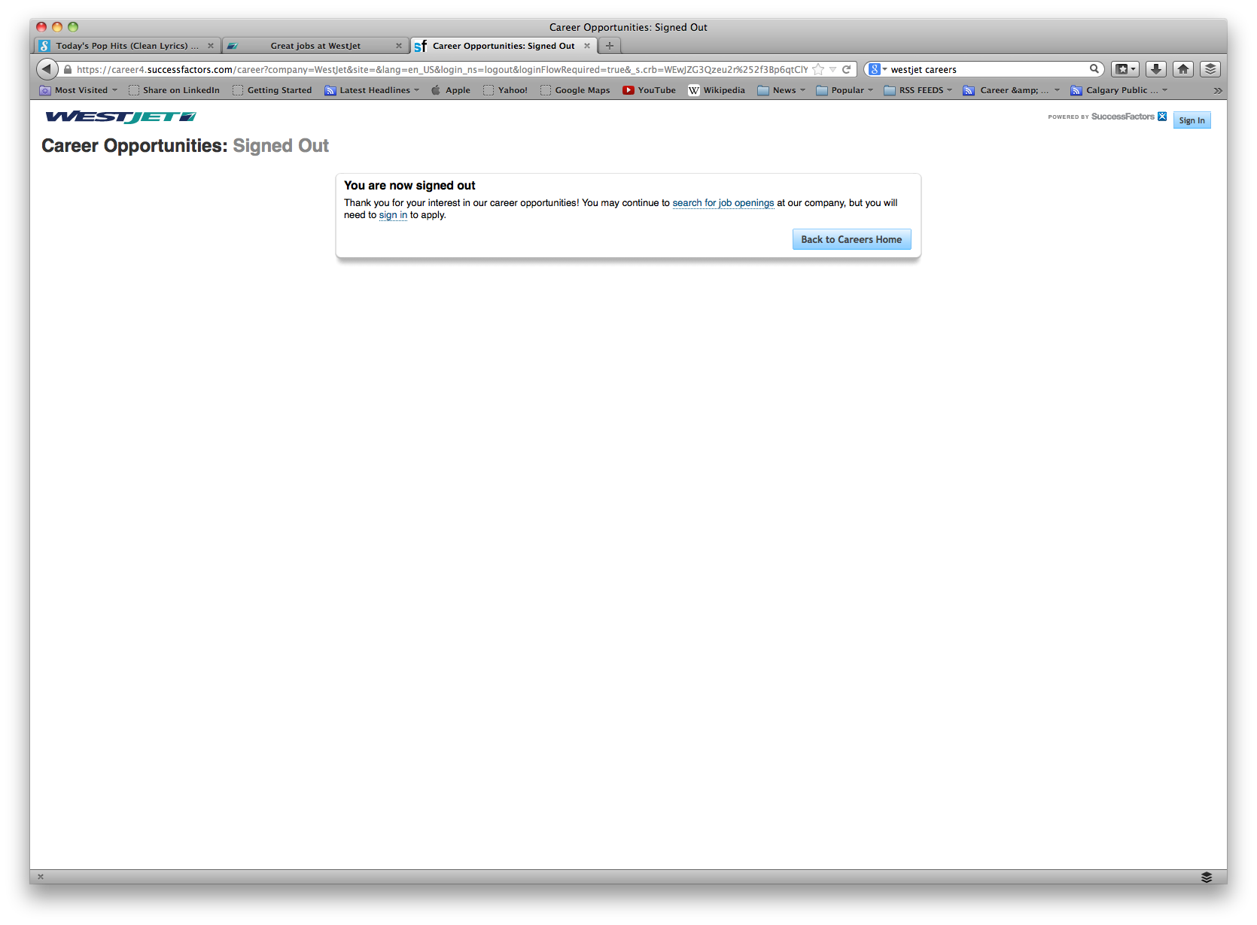
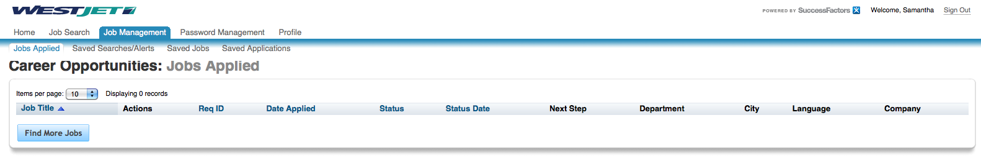
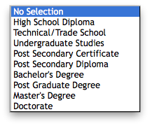
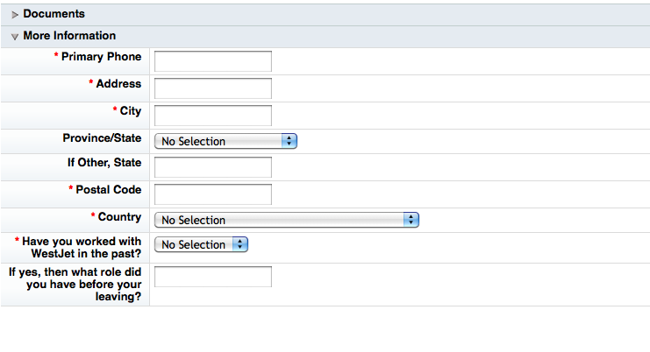
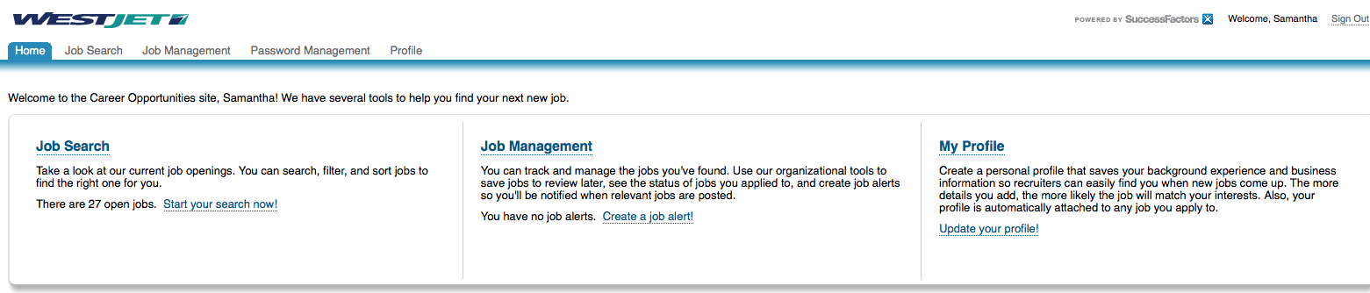
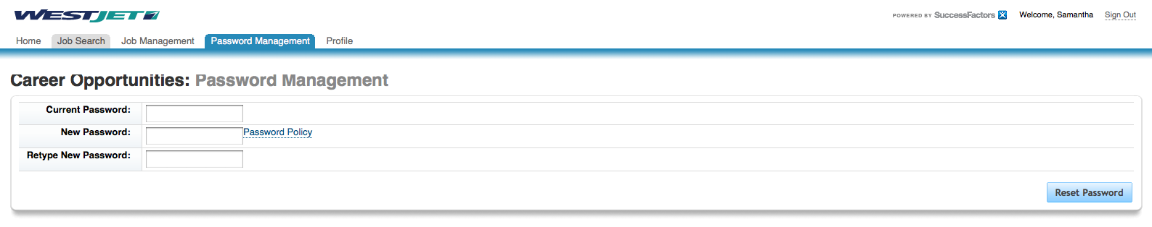
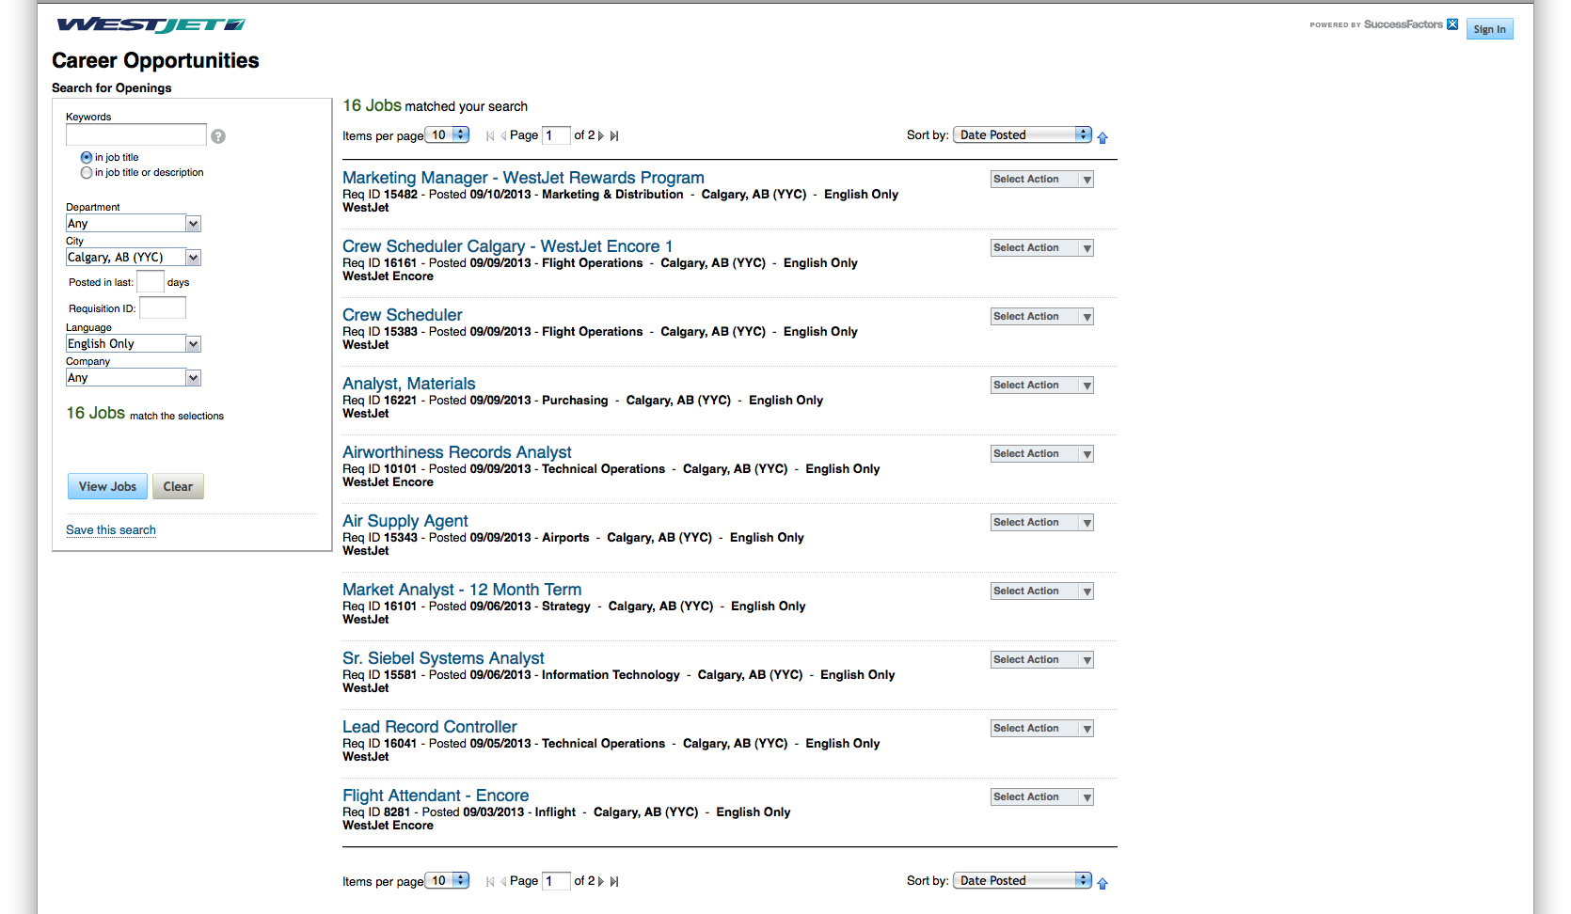
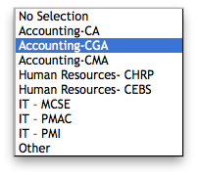

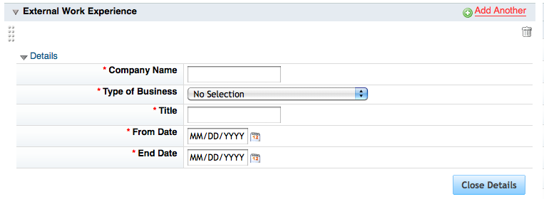
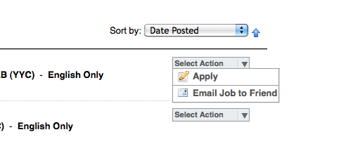
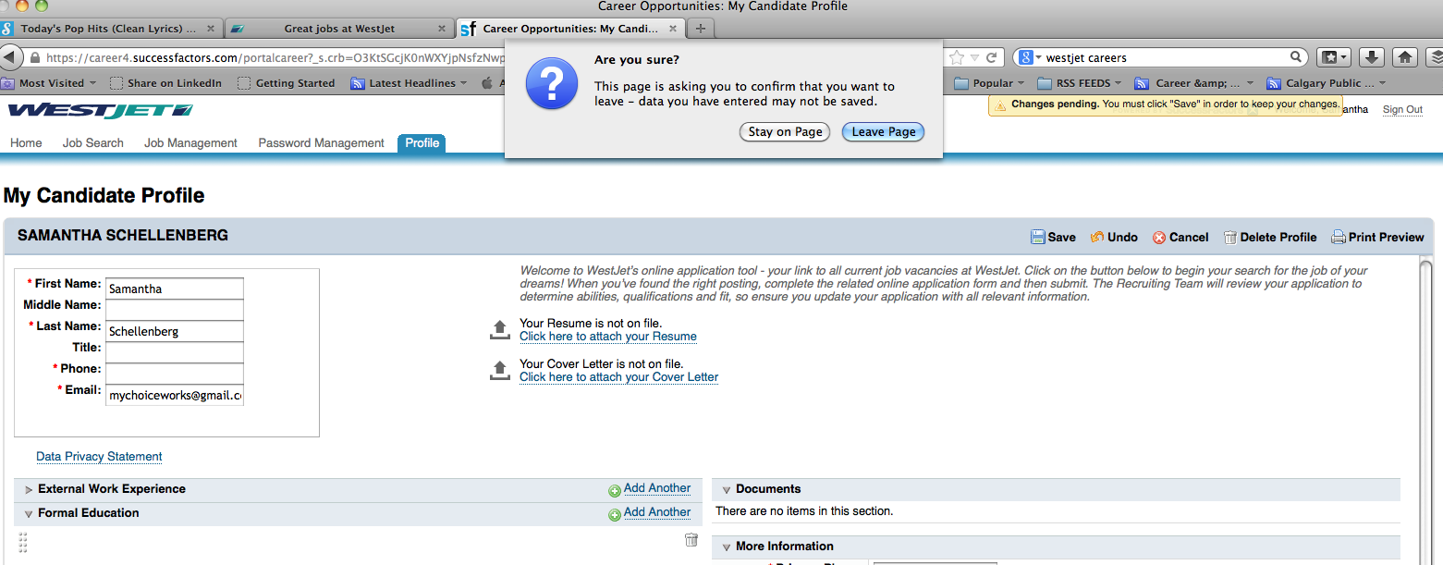
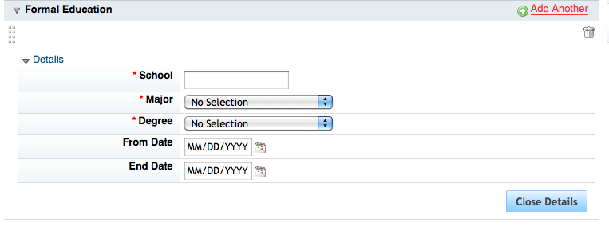
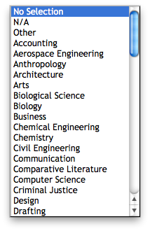
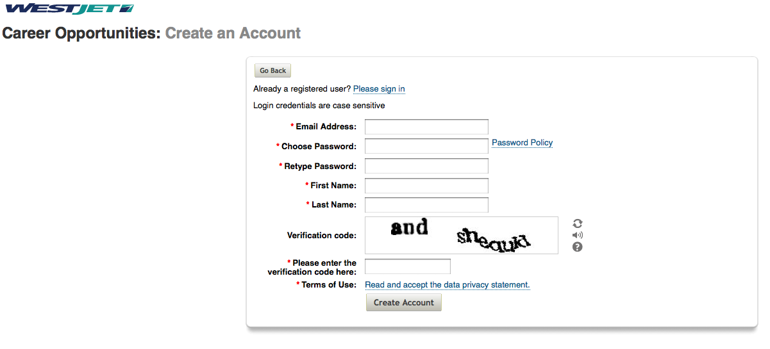
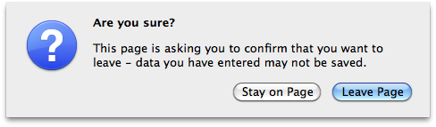
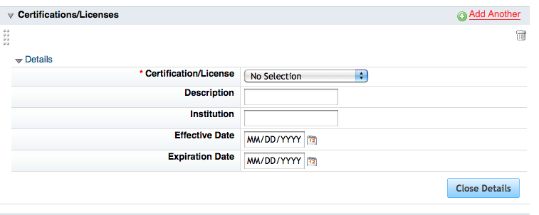
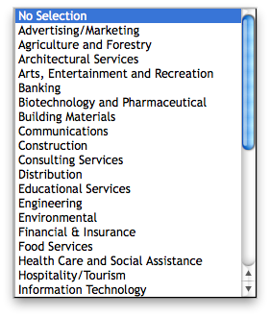
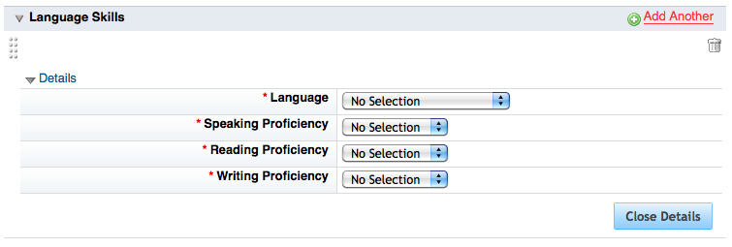
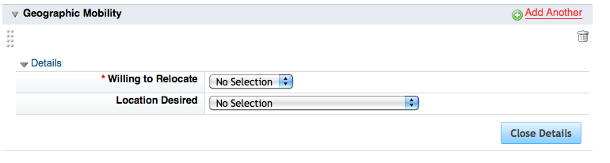
REALITY CHECK

Slide 5
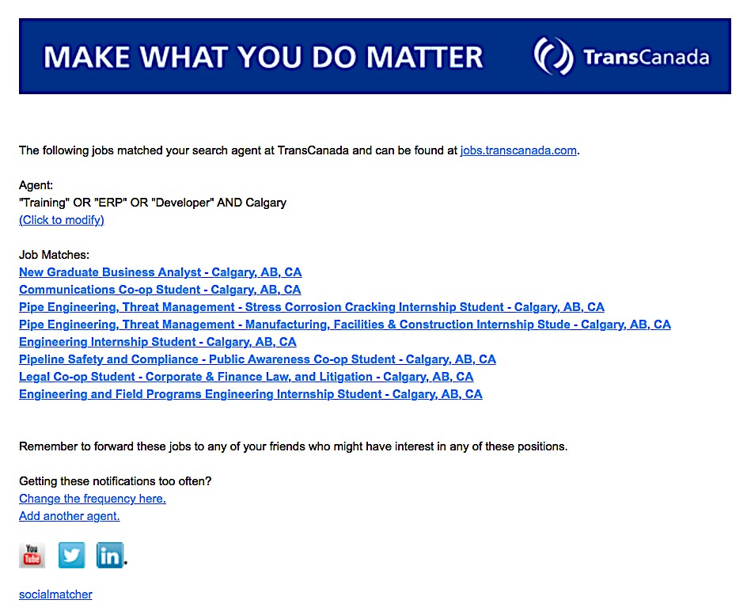
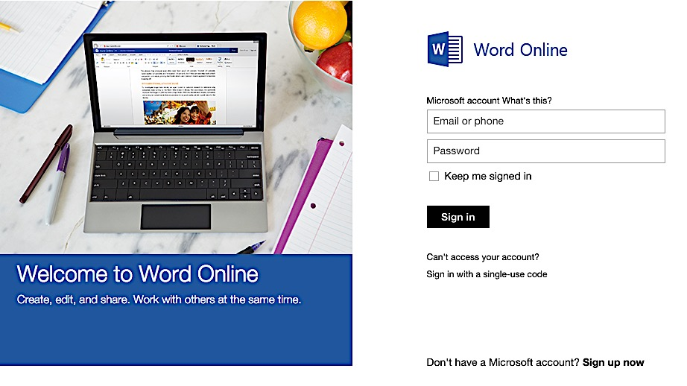
TECHNOLOGY
CLOUD TECHNOLOGY
KEYWORD JOB ALERTS
Notes:
JOB SCAN LINK:
OPTIONAL DEMO: COPY AND PASTE resume text to assess “scanability”: https://www.jobscan.co/#.VusbxafezI4.linkedin

Slide 6
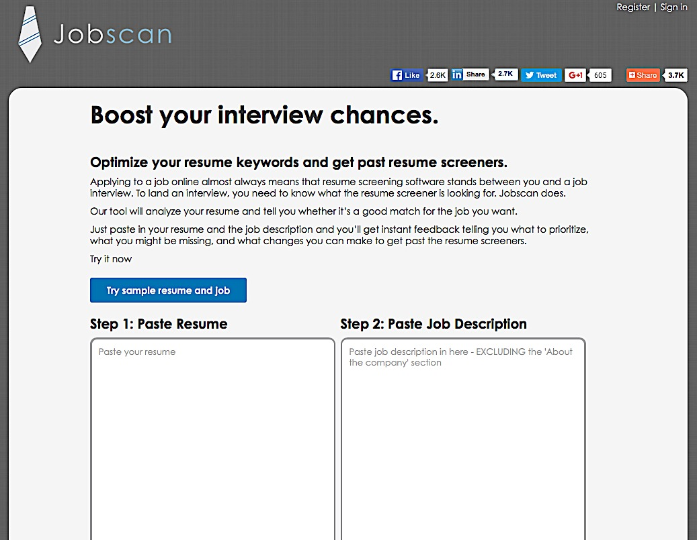
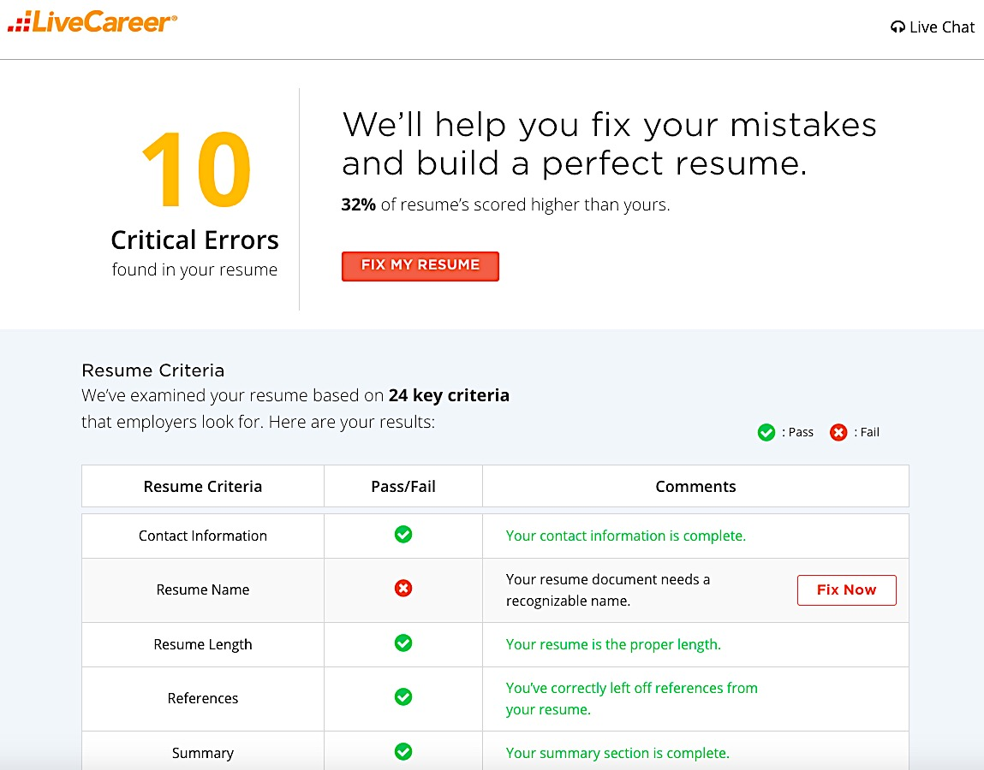
SCANNING TECHNOLOGY
JOB SCAN
LIVE CAREER
Career Guidance: “Teaching clients not what to do differently but how to think differently”
Notes:
NOTE: TECHNOLOGY is NOT a substitute for real knowledge and research on the position. Writing a resume to beat technology is only half the challenge.
CAUTION: These are businesses looking to capitalize on immediate needs of job seekers.
PAYING for job seeker premium on LINKEDIN to rise to the top of the application pile, has unintended effects since recruiters can see this has been done.
Ask yourself: Would you rather hire a candidate who has clearly paid to rise to the top of the job seeker resume pile, or the candidate who’s resume made it to the top because he had the correct qualifications and communication skill?

Slide 7
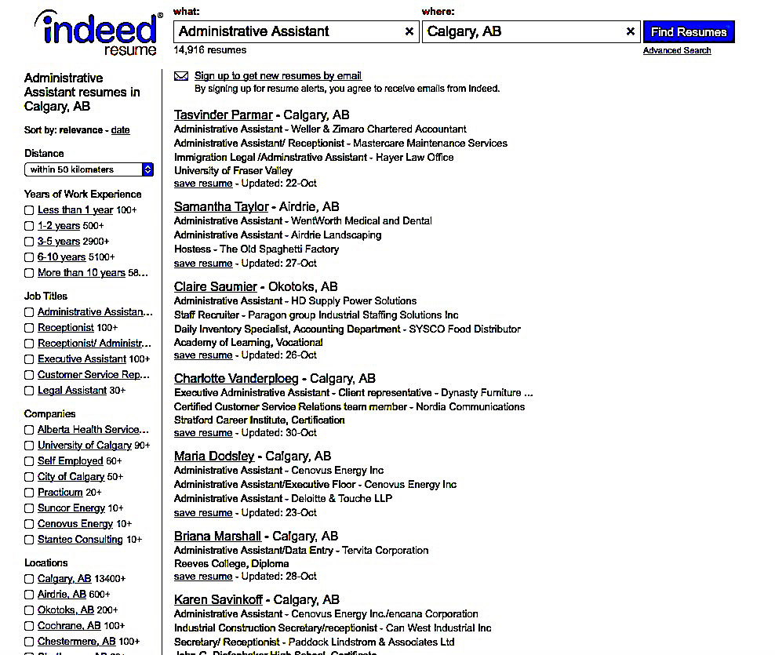
Write résumés that…
COMPUTERS LOVE
EMPLOYERS READ
Packed with keywords.
Easy to read… $ % #.
Clear, focused, concise.
Related experience only.
Appealing layout.
Concrete examples.
Action / Task + Results.

Slide 8
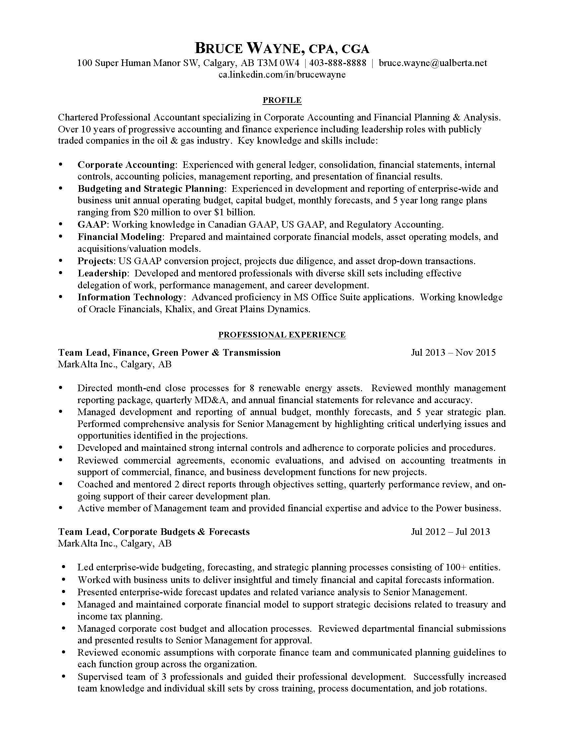
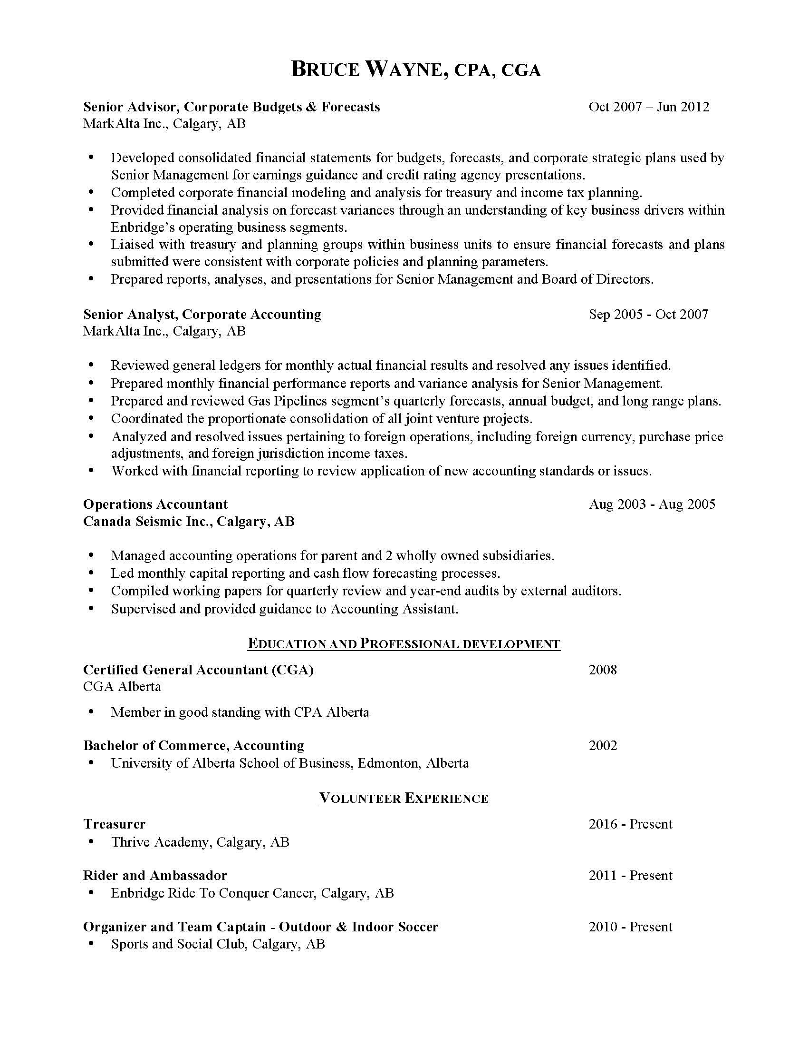
Chronological Format
Organized by job titles and dates.
Most recent job 1st, works backwards.
Preferred by large employers with ATS.
Highlights strong work history.
Shows record of promotion.
Proves experience, or shows lack of.
Exposes gaps / multiple job changes.

Slide 9
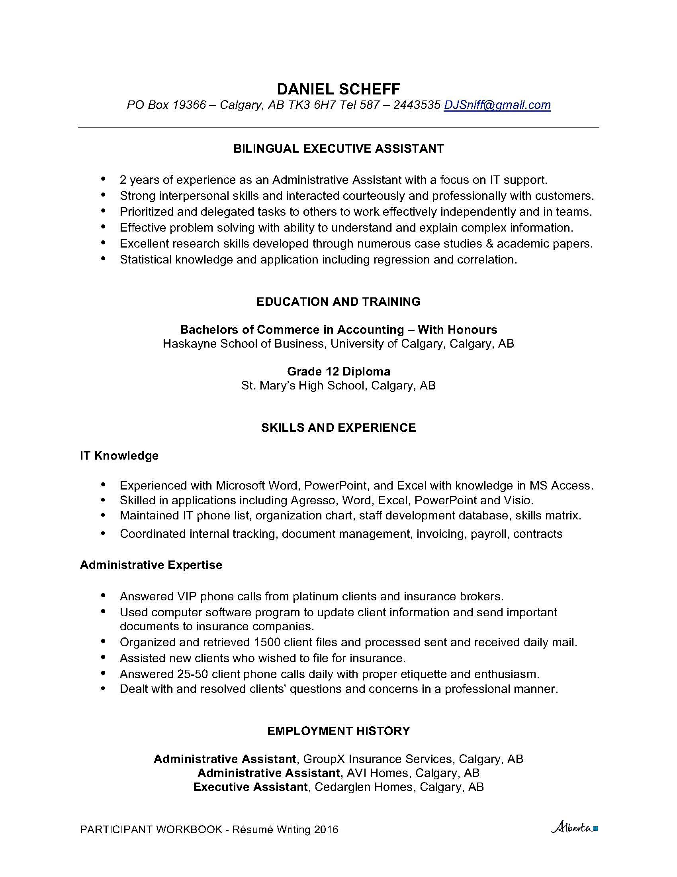
Functional Format
Organized by skill (function).
Emphasizes best strengths for the job.
Omits dates or specific where/when.
Limited employer response, lacks proof.
Not recommended for use in Calgary.

Slide 10
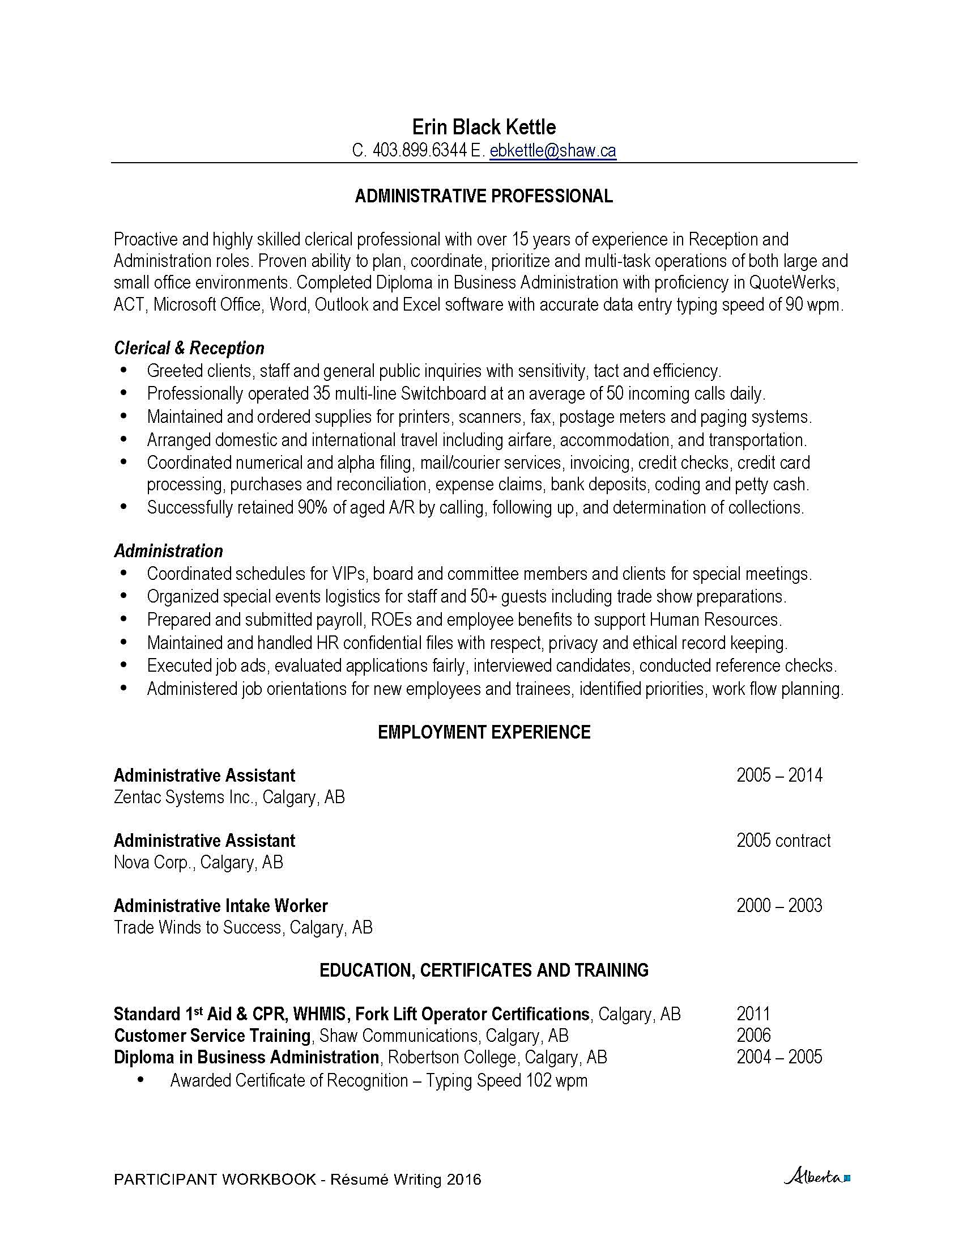
Combination-Hybrid Format
Organized by skill groups + dates.
Skill groups match core competencies.
Includes clear work history with “proof”.
Most effective for career changers.
Excellent for starting “conversations”.
Useful for targeting small and medium employers without ATS/HR staff.
Innovation, Science and Economic Development Canada: 98% of Canadian Businesses are small.
Notes:
ADD 85% of people in Alberta work in small and medium sized companies. As of December 2012, there were 1,107,540 employer businesses in Canada, as shown in Table 1, of which 1,087,803 were small. Small businesses make up 98.2 percent of employer businesses, medium-sized businesses make up 1.6 percent of employer businesses and large businesses make up 0.1 percent of employer businesses.

Slide 11
Modernize your résumé
Add a splash of colour.
Add hyperlink to your LinkedIn Profile.
Include website portfolio or other media.
Use | instead of bullets for skills section.
Be clear, concise, current and compact.
Target every single résumé.
Create a printable and postable version.

Slide 12
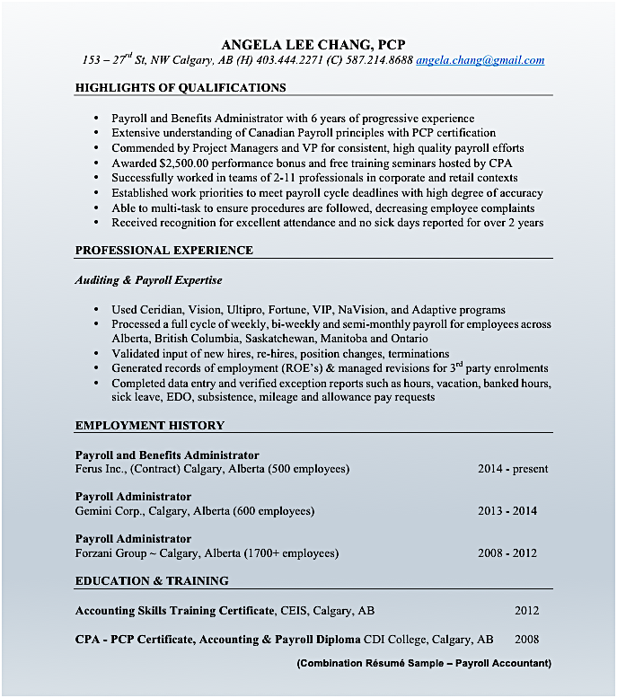
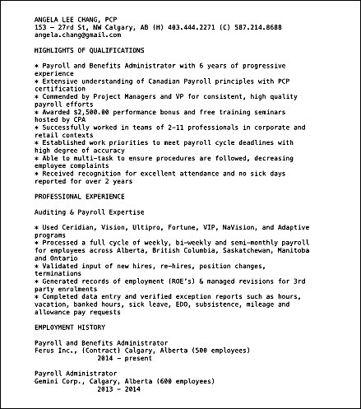


PRINTABLE RÉSUMÉ
POSTABLE RÉSUMÉ
Notes:
RESUMES 101: HEADINGS AND FORMATTING
UBC Career Services YouTube Channel
www.ubc.ca/career/resources/resume

Slide 13
TECHNICAL COMPETENCIES

Slide 14
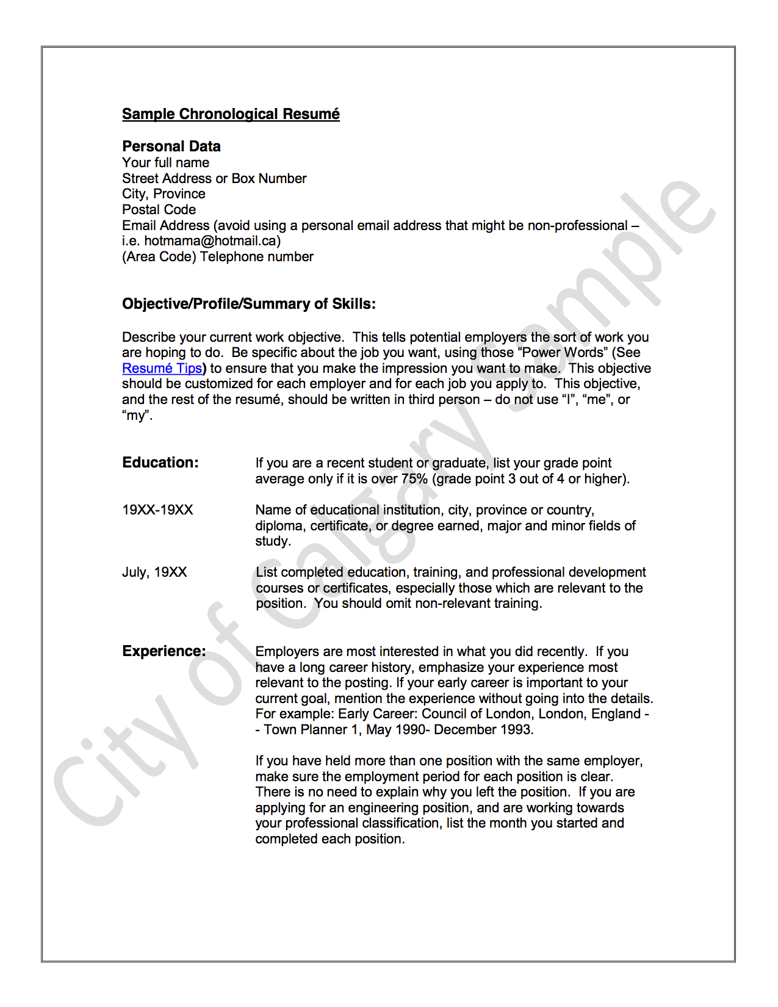
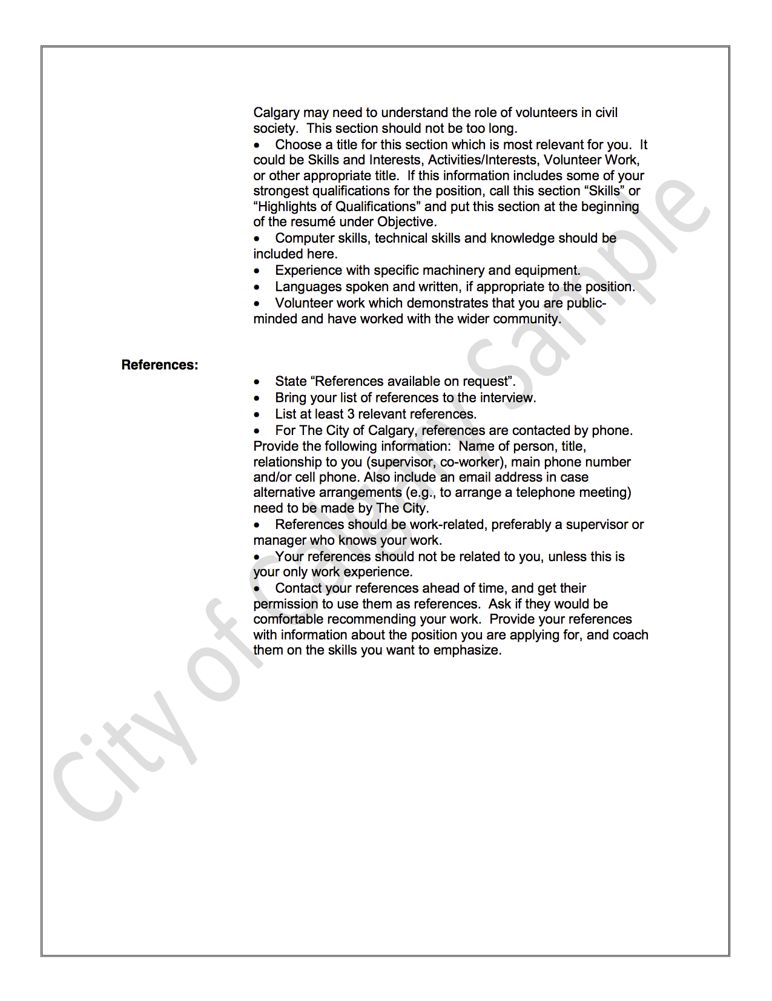
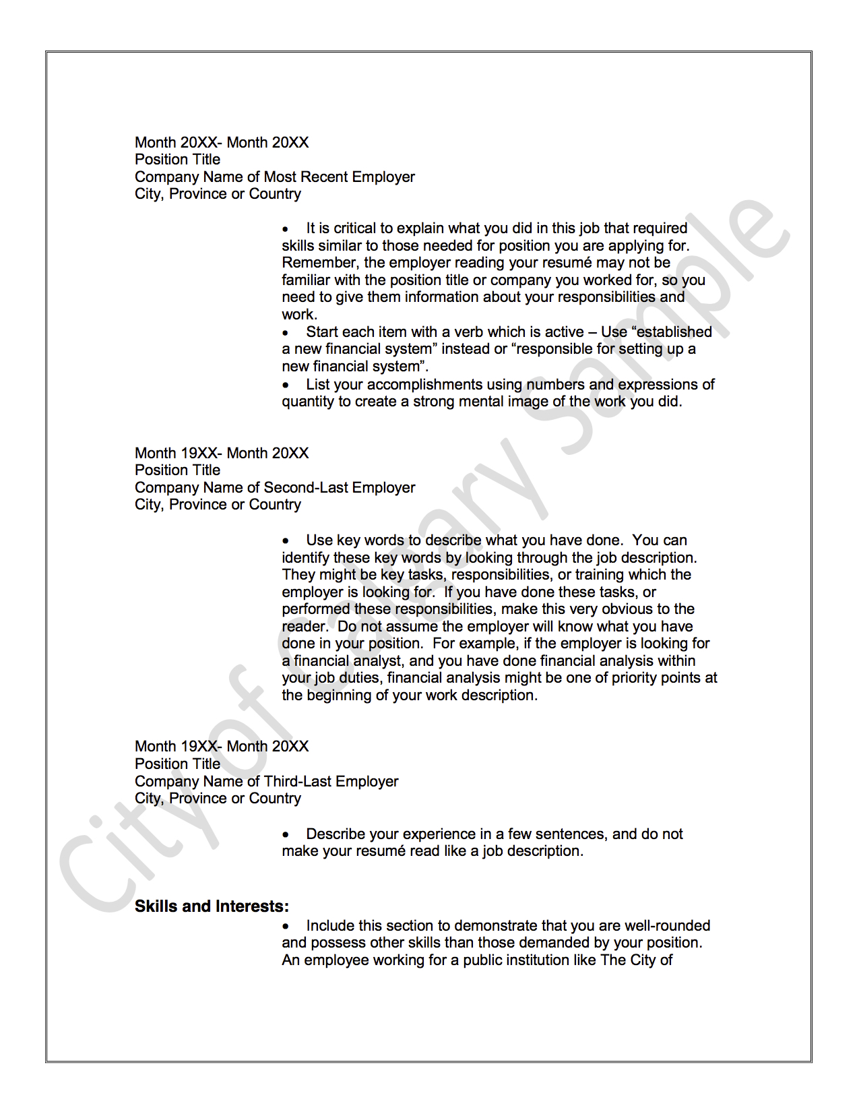

Slide 15
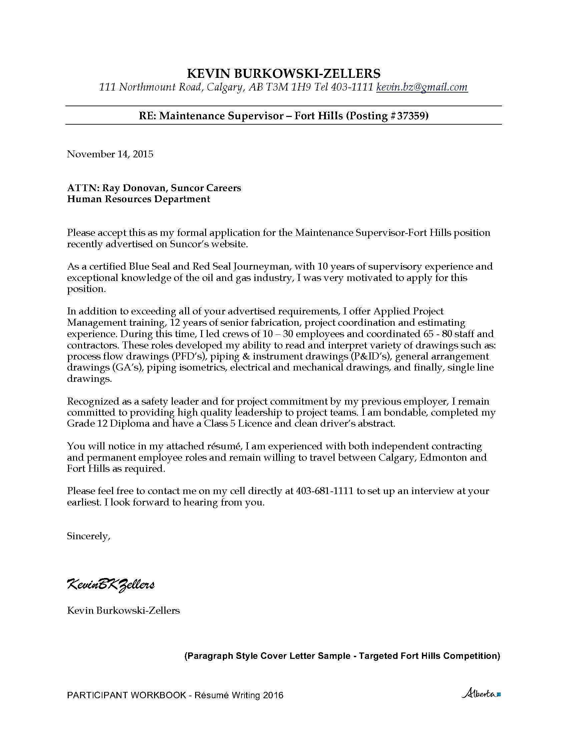
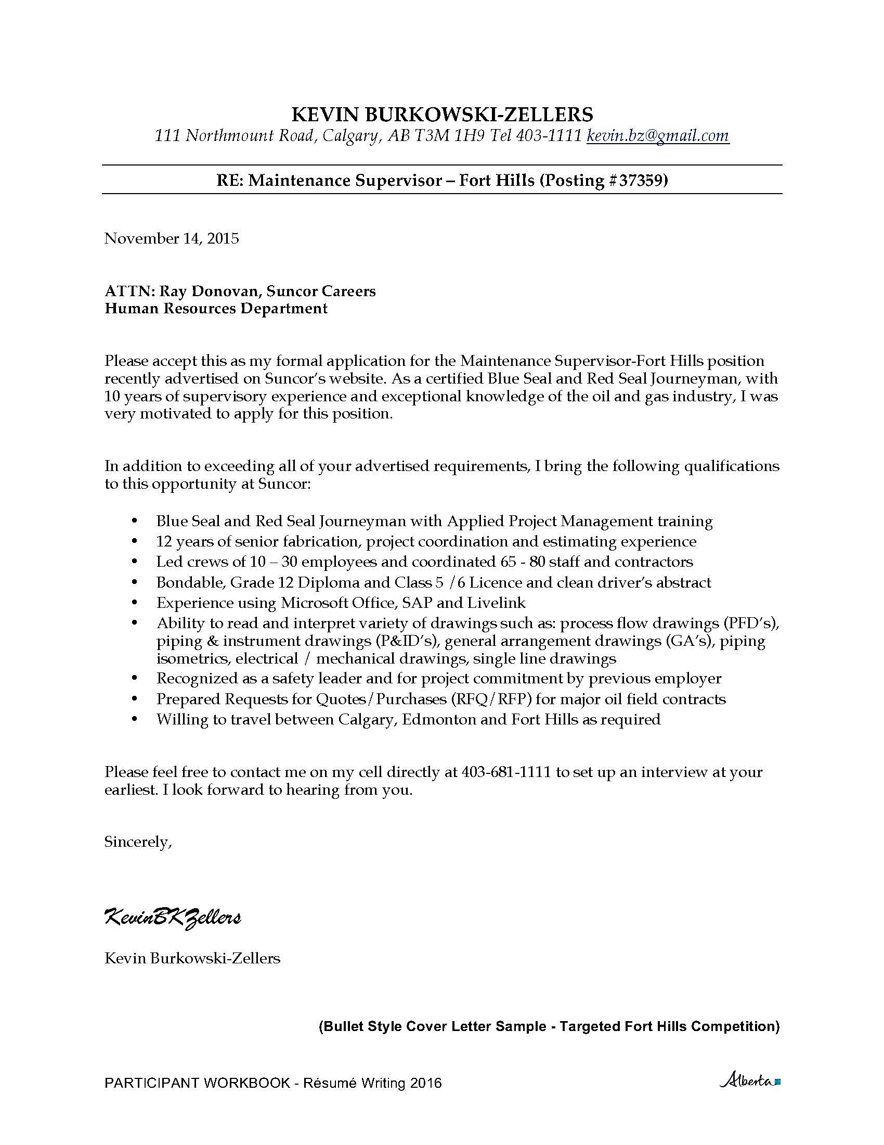
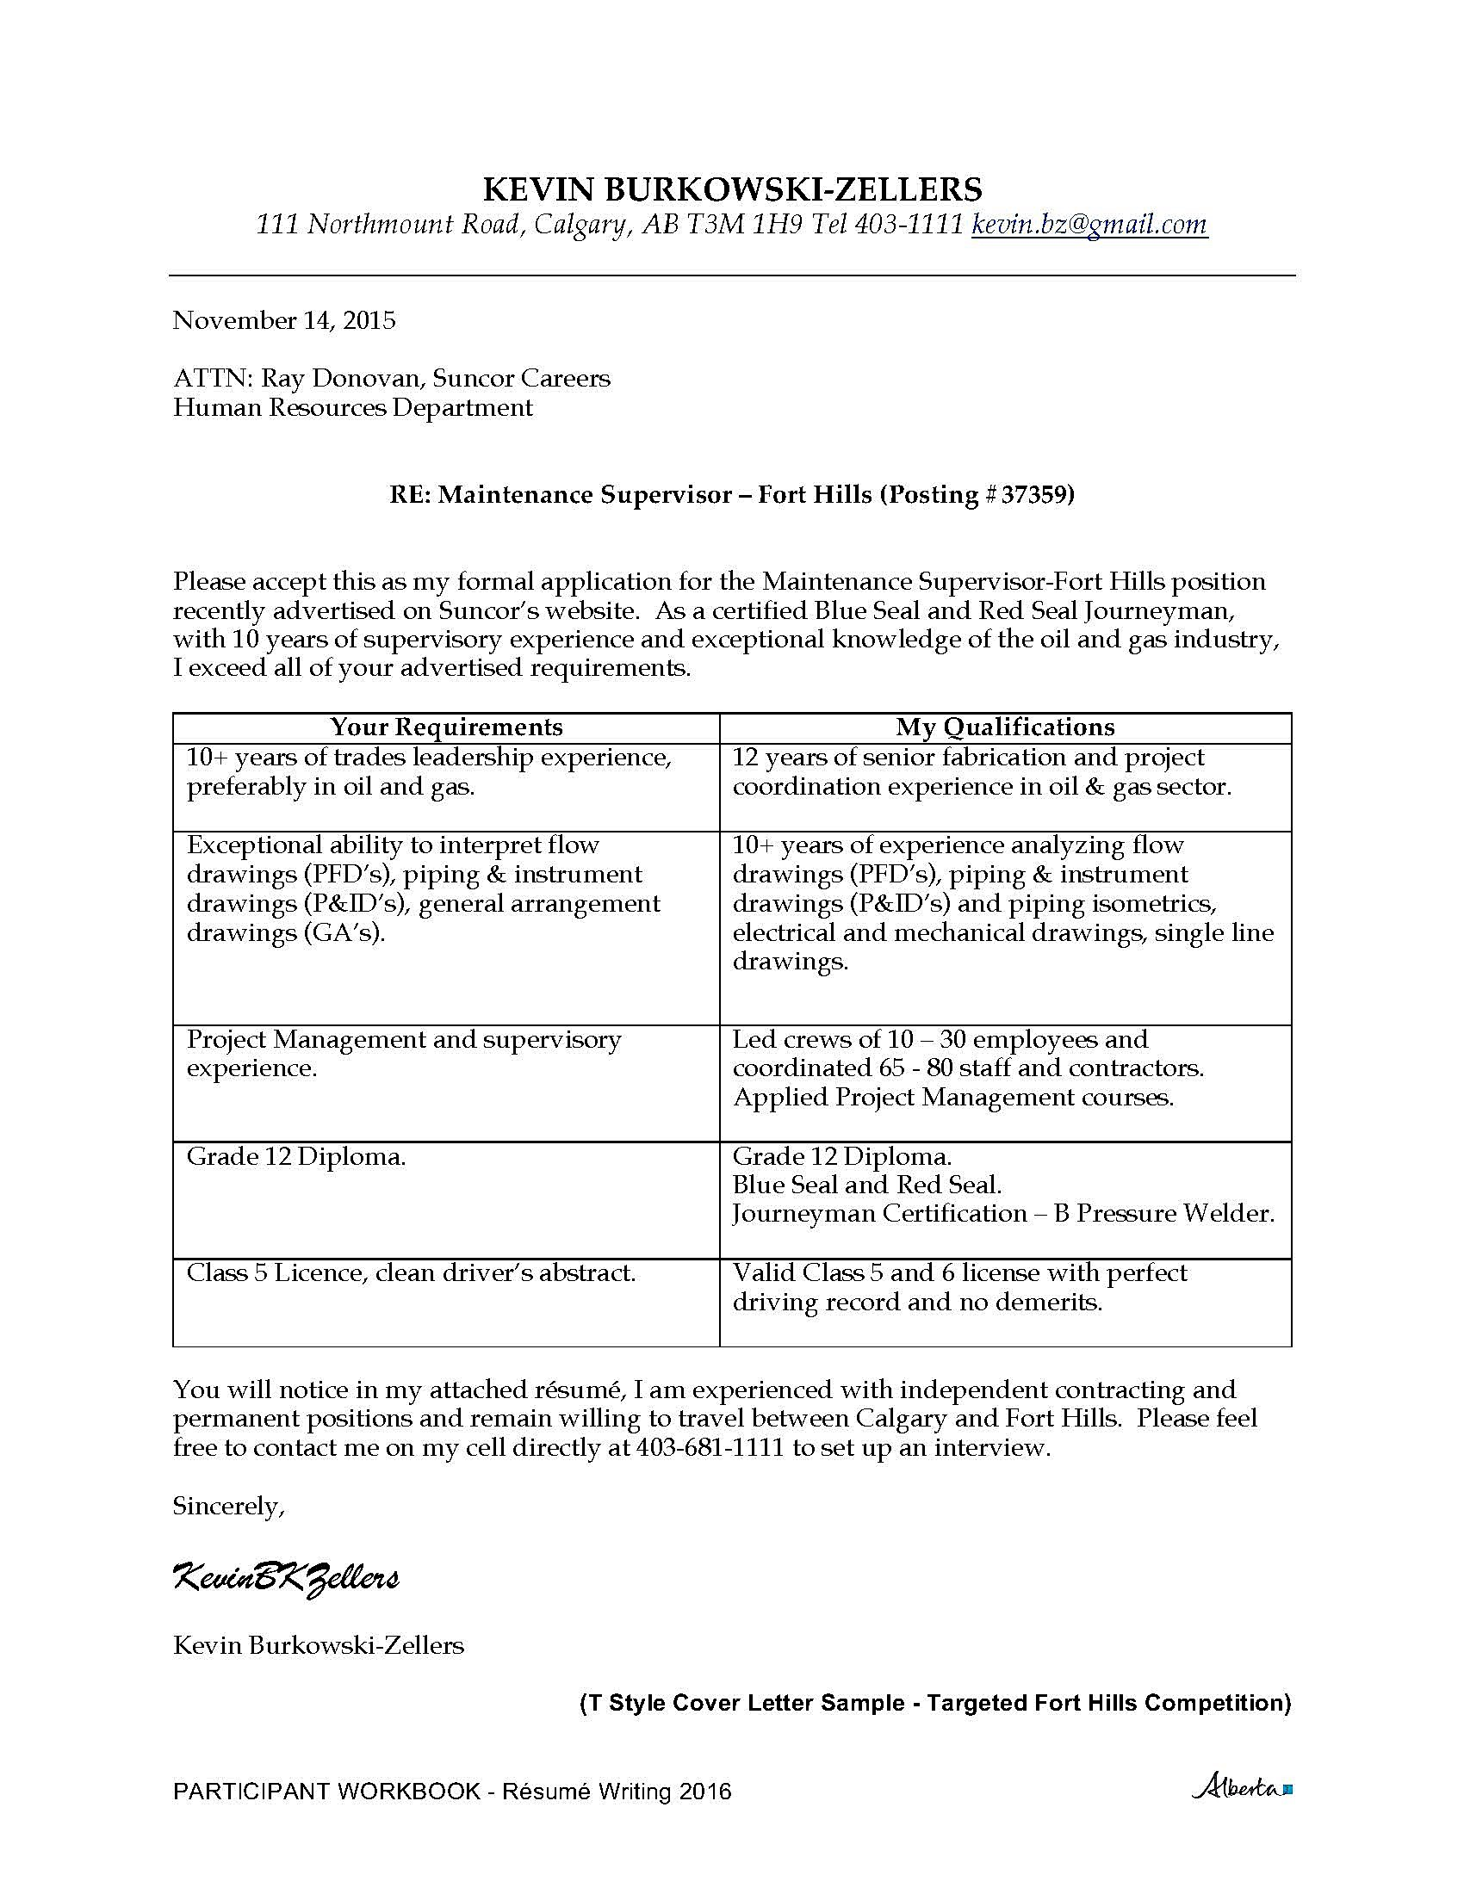
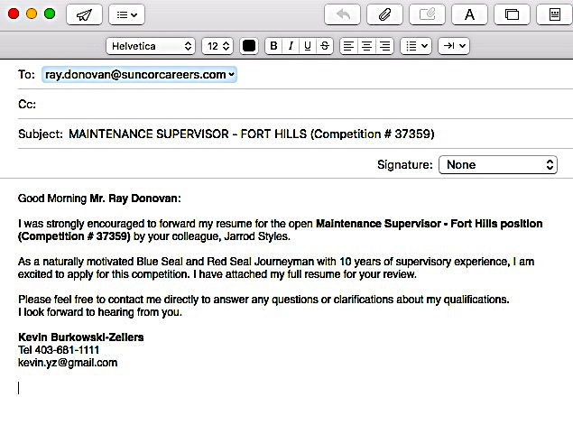
COVER LETTERS

Slide 16
REFERENCE SAMPLES

Slide 17
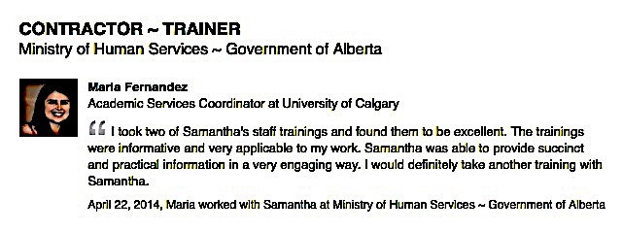
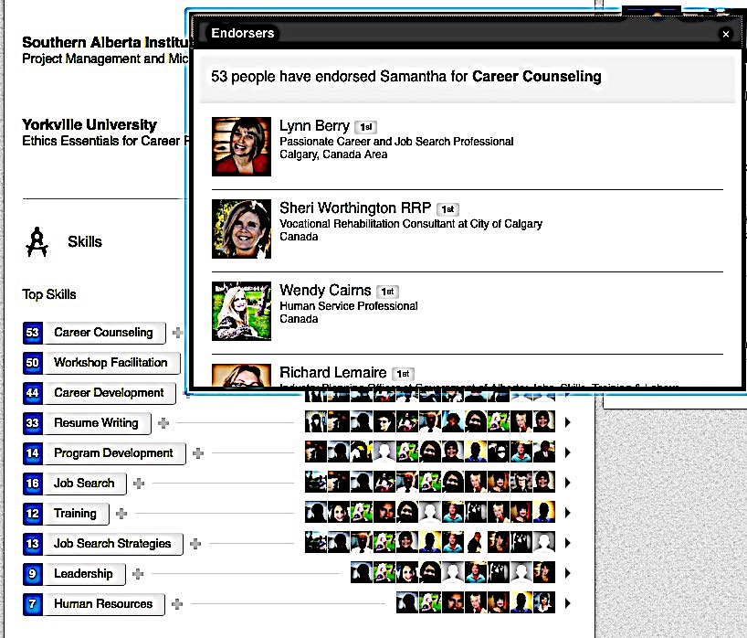

RECOMMENDATIONS
ENDORSEMENTS & TESTIMONIALS

Slide 18
“Hi Samantha,
I am pressing forward with my job search daily. I had one pre-interview yesterday with a company that was screening applicants for the (real) 2nd interview. I know from the responses and comments made to me that the Hiring Manager thought my age was a negative factor. He made comments like ”We are looking for longer term commitments in the Human Resources Manager Position - not 5 years, but 20 years”. The positive information I gained from him is that there were 3,300 applicants for that 1 position and I secured an interview with my resume. I am sure they are using an electronic program to screen applicants if their recruitment efforts are that far reaching. I have been invited for another interview in the New Year.”

Slide 19
Collaborative Small Groups
Share your own case study of “The Impossible.”
Collaboratively build a résumé writing & résumé critiquing Top 10 List of Best Practices.
Choose a writer and a speaker.
Notes:
SMALL GROUP – 20 MINS

Slide 20



CONTACT INFORMATION
SAMANTHA SCHELLENBERG, BA, RRP, CCDP
www.choiceworks.ca
ca.linkedin.com/in/choiceworks
@choiceworks

