Slide 1
Career Recrafting in a Tough Economy
By Jane Schreiber
janeschreiber@shaw.ca
Jane.Schreiber@gov.ab.ca

Slide 2
“The world is your oyster” Shakespeare
Highly competitive for job seekers
Fewer positions in some industries
Employers have pick of candidates
Passive job searches take longer

Slide 3
The Essence of Jobs in a Tough Economy
Career laddering with same company is rare
Wages and benefits – large cost
Each position must fulfill an economic purpose
Staff budgets align with positions

Slide 4
Job Search Method
Matching skills with employer needs
Need to understand skills
Need to understand employer needs
Repackaging competencies
Deconstructing past positions (including volunteer)
Reconstructing to new position

Slide 5
Job Search Quickstart Guide
Succinct
Focuses on relevant skills
Can work for most job titles
Go through process with each job title
Is most useful after the job seeker has chosen the position they are targeting
Job Search Quickstart Guide
Step 1: What is the position you feel most confident you will succeed in getting?
_______________________________________________________________________
Step 2: What are the top 5 skills required for this position?
__________________________________________________________________________
__________________________________________________________________________
__________________________________________________________________________
__________________________________________________________________________
__________________________________________________________________________
Step 3: What did you do at your previous jobs that demonstrate these skills?
Job Title:__________________________________________ Year-Year ___________
Company: _____________________________ City, Province: ______________________
___________________________________________________________________________
___________________________________________________________________________
__________________________________________________________________________
_Job Title:__________________________________________ Year-Year ___________
Company: _____________________________ City, Province: ______________________
___________________________________________________________________________
___________________________________________________________________________
___________________________________________________________________________

Slide 6
Target Job Title
What is the position you feel confident you will succeed in getting?
It is the job seeker’s responsibility to figure out what will work for them.
Many variables impact a jobseeker’s decisions
CDPs might be able to give some ideas that the job seeker could investigate
Job Search Quickstart Guide can be used to investigate position options

Slide 7
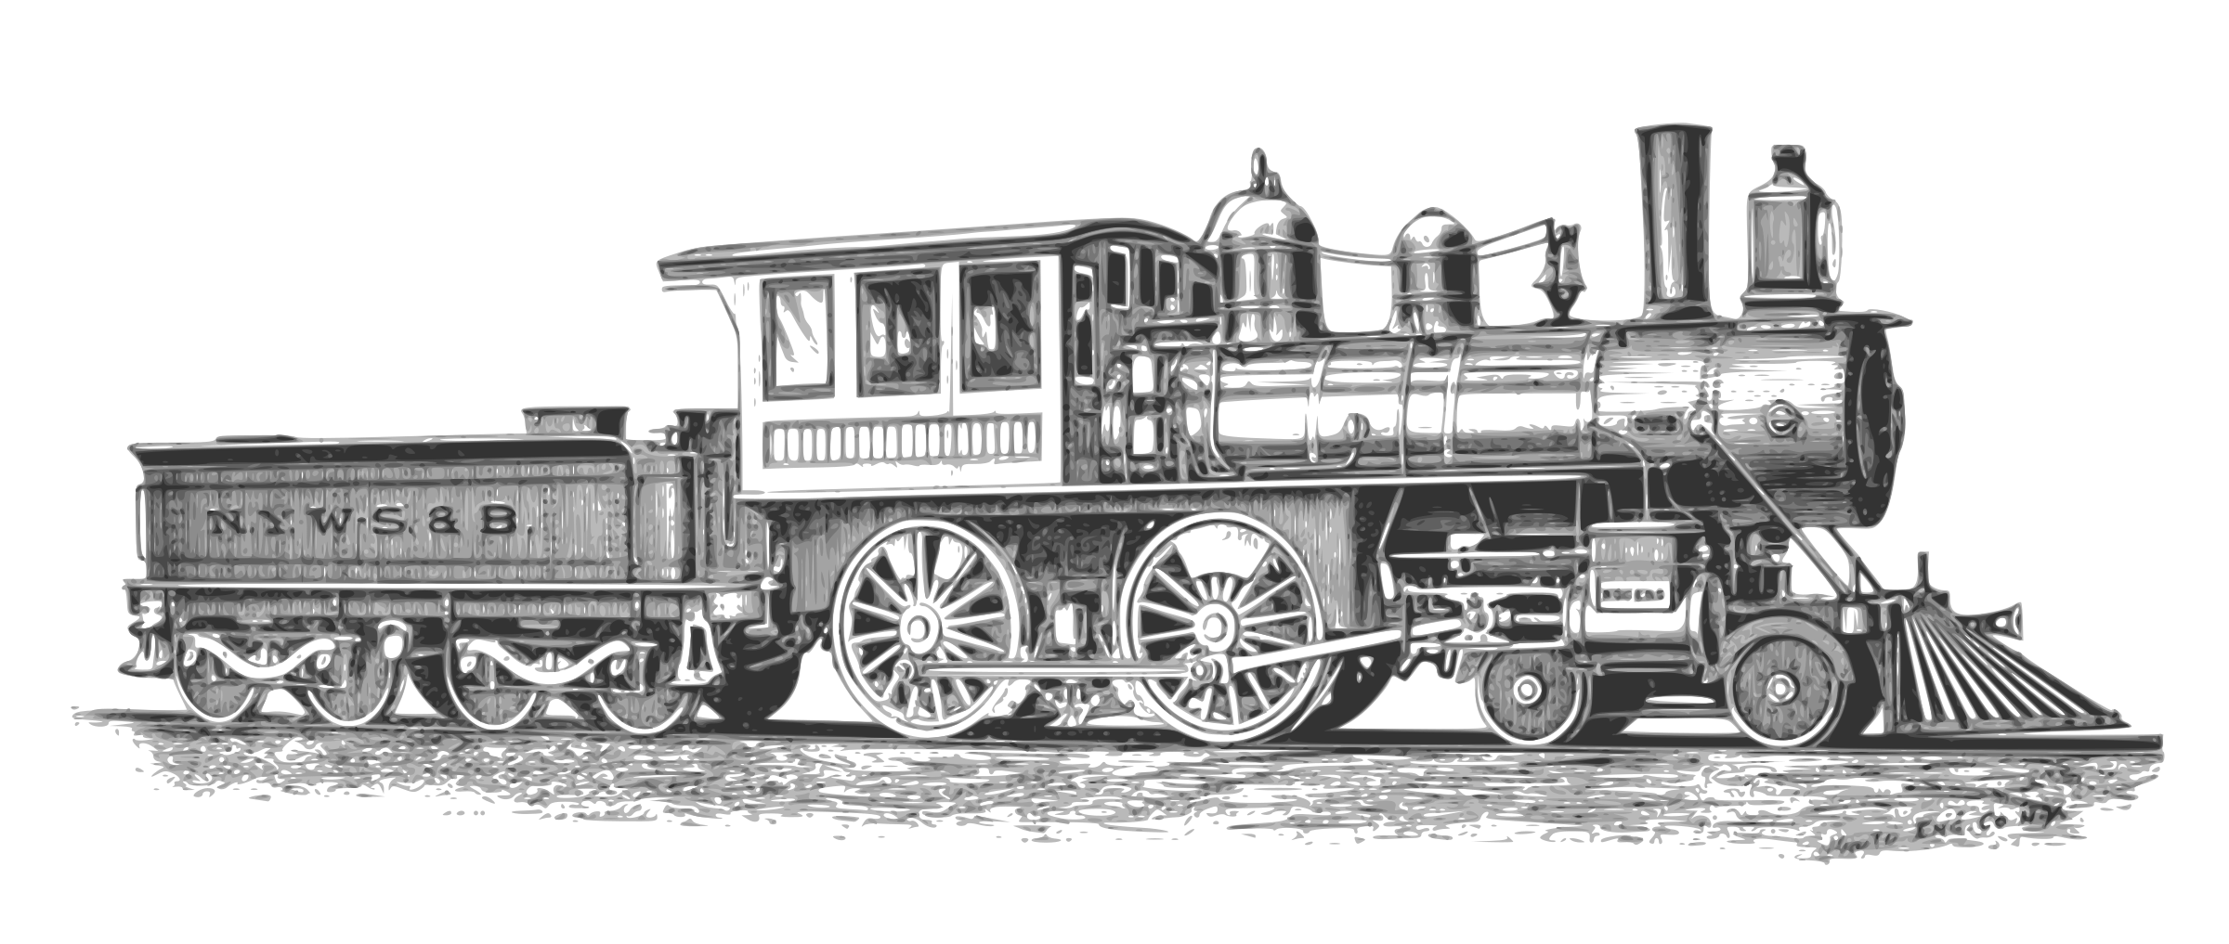
Transferable Skills
Job-specific skills
Relevant for new environment
Onus on job seeker to translate skills
80% of job search is work of job seeker

Slide 8
Deconstruct previous work
Repackage skills into different combinations that suit related jobs
Create a “Master Resume” of skills used in past
Paid employment
Volunteer opportunities
Schooling
Projects

Slide 9
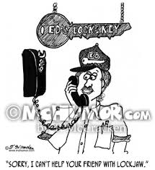
Understand the Value Premise
Help job seeker position themselves as possible candidate
Express skills and experience related to employer’s needs
What skills are still missing?
Volunteer
Take a course
Read about the subject on the Internet

Slide 10
Current Situation
Restrictions/Barriers
criminal record, family situation, lack of driver’s license/clean abstract
Level of Education/Language proficiency/Familiarity with technology
Physical/Mental Capacity/Health/Energy Level
Confidence levels/Mental wellness
Attitude
Level of investment and ROI
Interests/Aptitudes/Values
Economic realities

Slide 11
Top 5 Skills of Target Position
Number of years of experience
Job-specific skills
Compare 3 job postings
Do Information Interviews
Get insider information

Slide 12
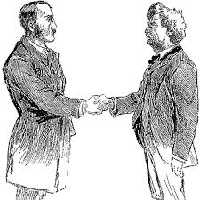
Competencies/Skills Job Seeker has that match position
Providing credibility
Building a case to hire them
Employer sees connection immediately
Translate skills using terminology relevant to new position
Discussing skills less specific to previous field

Slide 13
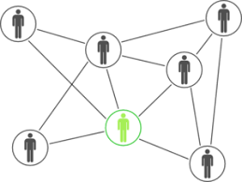
Clearly presenting skills and experiences relevant to position
What did you do at previous jobs (usually last 10 years) that demonstrates skills the employer is seeking?
Connect with employers who have the position in their organization
Insider information
Timing of opportunity
Other possibilities
Referrals to people in similar organizations

Slide 14
Timing
Is the timing right?
Is it coming?
If not, does the job seeker try Plan B or C?

Slide 15
Activity #1 Top 5 Skills
Jobs requiring little or no prior training:
Labourer/production
Food prep/food service and
Cleaner/janitor
Customer service/cashier
With some training/post-secondary:
journeyman trades – welder, electrician,
security guard
Class 1 driver
admin assistant
With degree:
software developer
accountant
manager
social worker
Top 5 Skills

Slide 16
Successes I’ve seen
Oilfield Motorman to Construction Supervisor
Food Scientist to IT Manager
School Janitor to Security Guard
Marine Ship’s Captain to Warehouse Manager
Former Olympic Athlete to Non-profit Manager
School Bus Driver to Employment Counsellor
Structural Engineer to Project Manager
Land Surveyor to Home Inspector
Pharmacist/Store Owner to Retail Shelf Stocker
Teacher to Employment Counsellor
Teacher to Communications Manager
Construction Foreman to NCCO
Construction Foreman to Locksmith
…

Slide 17
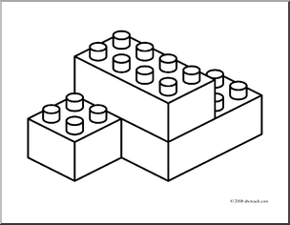
Activity #2 Examples of Reconstructed Careers
In your groups, please come up with some examples of reconstructed careers and why they worked. If you have a few examples of ones that were not successful, please indicate why they did not work.
Please write them on the inside of the pink number card with the original job title → new position title

Slide 18
Connect by LinkedIn or Email
janeschreiber@shaw.ca
Jane.Schreiber@gov.ab.ca
Would you be willing to test the Job Search Quickstart Guide and provide feedback? Send me an email to let me know.
Thank you for your time!

Slide 19
Transitions that Worked
Probation Officer → Career Developer Supervisor
Teacher → Project Coordinator, Non-Profit
Banker → Sales Rep
Language Instructor →Soft Skills Instructor
Dermatologist → Retail
Technician → Computer Camp
Military → Security Guard
Military → Management
Business person → Sales
Teacher → Car Sales
Firefigher → Car Sales

Slide 20
Transitions that did not work
IT Tech Manager XXX Retail

