Slide 1
Career Development Association of Alberta ACDC Conference 2018
Goals, Metrics & Communication
for Career Centre’s

Slide 2
Outline
Introduction
Jenny Cruickshank
Leader of the Engineering Career Centre team, focused on career skills for engineering students and engaging with student, community, industry and academic faculty.
Career in Human Resources; graduated from the University of Toronto & Fanshawe College and am a Certified Professional Human Resources (CPHR).
Jenny.Cruickshank@ucalgary.ca
By a show of hands, who is with us today?
Employers
Educators
Independent Career Professional
Learners

Slide 3
Plan for Presentation
Goals: Build a bridge from academic learning to work integrated learning & graduate career-ready professionals
Metrics: measure what Career Centre’s contribute
Communication: Measure what Career Centre’s do & communicate it properly

Slide 4
Goals
Notes:
A goal is where you want to be and objectives are the steps taken to reach the goal.
Oxford Dictionary: 2The object of a person's ambit ion or effort; an aim or desired result. 2The object of a person's ambition or effort; an aim or desired result.
Love the idea of this word art – you can see that Goal means different things to different people.

Slide 5
Goals
Define the purpose for your Career Centre
Questions you must find answers to
What are the strategic goals for your Faculty or Campus?
Schulich School of Engineering Strategic Plan: committed to student success, fostering diversity, research that makes a difference
Who do you provide services for? (audience)
Students – current, future, new graduates
Industry Partners
Academic Faculty
Broader University Community
What service model can you sustain?
Stop, Start, Continue

Slide 6
Goals
Define the purpose for your Career Centre
How to obtain this information?
Speak to staff team; understand what has been done and why.
SWOT – strength, weakness, opportunity, threats analysis – we did this as a unit in the first month I started, listening to the team was the easiest source of information.
Program documents or reports, any previous program reviews.
Ask students.

Slide 7
Insight Into Impressive Practices in Career Services Peter Dietsche, Feb 2017
http://ceric.ca/resource/insight-impressive-practices-career-services-reference-guide/ Published Feb 2017
Services are evaluated regularly
Services outcomes are measured
Services are delivered proactively
Staff collaborate/partner with campus stakeholders
Partners needs are met
Value of services is demonstrated
Department strategic plan aligned with institutional strategic plan

Slide 8
Goals
“All graduates of the Schulich School of Engineering will have engineering related employment experience”.
Notes:
What is your Career Centre trying to accomplish?
Big Hairy Audacious Goal

Slide 9
Goals
Engineering Career Centre Established 5 Priority Areas
Work integrated learning experience
Relationships with Academic Faculty
Career Preparedness Programming
Donor Relationships
Internship Economic Environment
Notes:
What is your Career Centre trying to accomplish?
Big Hairy Audacious Goal

Slide 10
Goals
Action Plans
Each goal has a specific action plan that helped define, what we meant.
Strategic planning was an active exercise, everyone contributed in advance and we had dialogue on our ideas (not brainstorming).
Outcomes
Team was involved in the transition to a Career Centre and what our goals would be.
We collectively developed metrics to present to our leadership.
Goals were specific, timely and identified who was the lead.
Notes:
What is your Career Centre trying to accomplish?
Big Hairy Audacious Goal

Slide 11
Goals
Questions to take back with you:
What are the strategic goals for your Faculty or Campus?
Who do you provide services for? (audience)
What service model can you sustain?
Ask these 3 questions of a partner in the room. This is your starting point.

Slide 12
Metrics
Goal: 500 Internship positions for 2017-2018
Actual: 417 Internship placements for 2017-2018
Comparison: 363 Internship total placements 2016-2017
Accomplished: 15% increase over 2016
Year to Date (tracked weekly) April 25, 2018
337 Internship placements 2018 vs. 273 Internship placements same time 2017
54.5% eligible internship students placed vs. 44.2% 2017-2018 same time
INTAKE & JOB STATS |  | SAME WEEK 2017 | Last Week | This Week
 |  | April 24, 2017 | April 16 2018 | April 23, 2018
 | Students approved to program | 620 | 620 | 621
 | Job Postings (Active/ Total YTD) | 17/472 | 11/749 | 8/760
 | Students hired for Internship | 273 | 325 | 337
 | Actual Internship Positions | 972 | 1290 | 1304

Slide 13
Metrics
Possible Goals for the Career Centre:
Student interaction
Student satisfaction
Job placement rates (co-op, summer, internship)
Work integrated learning experience
What can you report on?
Job Placement Rates
Positions posted
Student satisfaction survey
Industry partner survey
Academic faculty engagement
Graduate survey

Slide 14
Communication
Communication
Positive & persistent
Focus on improvement
Celebrate success: internal & external to team
Insist upon stretch goals

Slide 15
Communication
Best Practices
Relationship with academic faculty is as important as what you do
Successful communication
Timely, accurate, responsive
Delivery methods include: e-mail, in person, quarterly updates
Table Discussion
What communication can your Career Centre:
STOP
START
CONTINUE

Slide 16
Communication
Engineering Career Centre example:
STOP
Internship student reports as the academic component (2015) which meant no marking for academic faculty, created new online modules for professional skills
START
Providing quarterly updates via e-mail, in person
Fall yearly attendance at Faculty Department Meetings
Follow-up on potential contacts, academic faculty travel packages created
Publishing goals for internship, talking about challenges
CONTINUE
Weekly tracking for internship, site visits, jobs posted
Recognition of each team member contribution, we are as strong as our weakest link

Slide 17
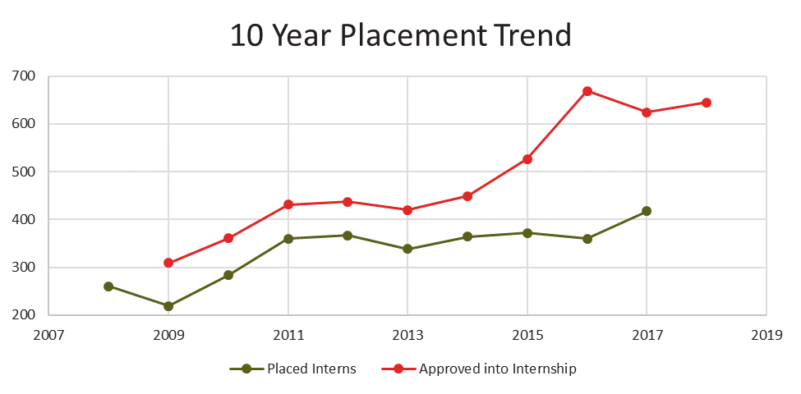
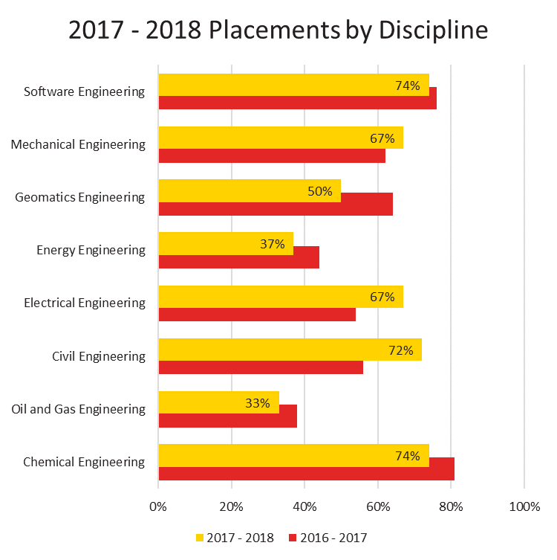
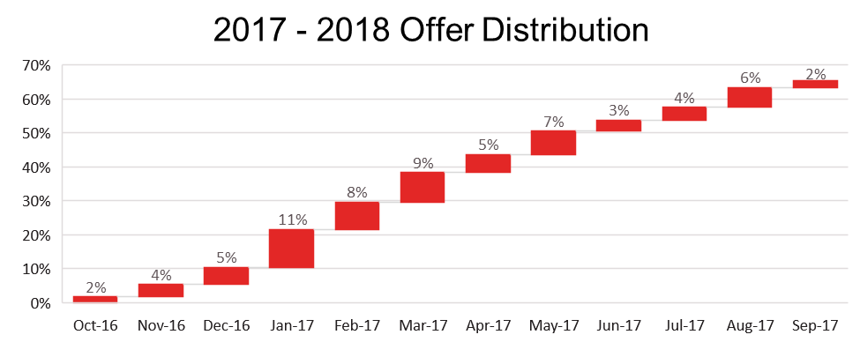
Expectations

Slide 18
Expectations
Campus Partnerships are key, find champions for your vision.
Resources are limited, how you leverage them is not.

Slide 19
Expectations
What we did differently
Career Pop-Ups vs. Appointment system
Panel Speaking events vs. filling massive auditorium
Coffee Chats vs. presentations
Encouragement & engagements vs. strict rule following
Service focused results that we can verify with metrics vs. metrics only
BHAG drives us all

Slide 20
Expectations
Things learned from:
Each academic year means students who require different levels of support
Career-Chats did not resonate with students (title)
Marketing campaign did not provide results (suspended)
When you think you’ve got it settled, the cohort of students changes and expectations change

Slide 21
Evolution
Goals: Build a bridge from academic learning to work integrated learning & graduate career ready professionals
Metrics: measure your impact.
Communication: broadcast the impact loudly!
Enjoy what you do, influencing students & their careers.

