Slide 1
Continuing to Connect Career Development & Mental Health
Dave Redekopp & Michael Huston
ACDC 2019

Slide 2
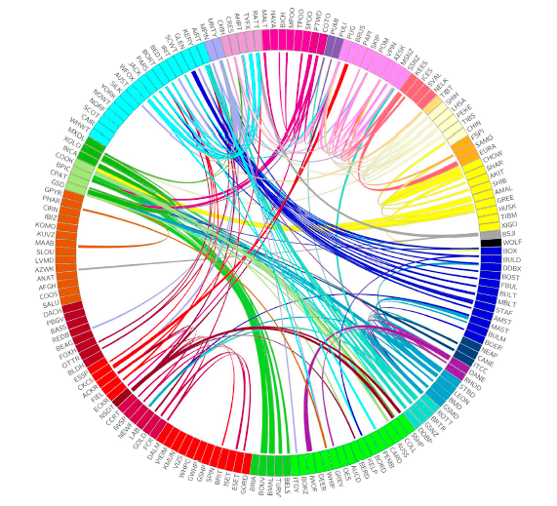
Overview
MI
CD
MH
Work
4
Notes:
Emphasize the public perception that “career development” is the same as “find work”
We need to differentiate the effects of work on mental health and the effects of intentional career development on mental health
What do we know, what do we not know, and what can we do?
***
The figure comes from the National Institutes of Health in the US:
Genomic Analyses Reveal the Influence of Geographic Origin, Migration, and Hybridization on Modern Dog Breed Development
Heidi G. Parker,1 Dayna L. Dreger,1 Maud Rimbault,1 Brian W. Davis,1 Alexandra B. Mullen,1
Gretchen Carpintero-Ramirez,1 and Elaine A. Ostrander1,2,*
1Cancer Genetics and Comparative Genomics Branch, National Human Genome Research Institute, National Institutes of Health,
Bethesda, MD 20892, USA

Slide 3
Mental Illness
“Mental illnesses are… characterized by alterations in thinking, mood or behaviour associated with significant distress and impaired functioning” (PHAC, 2017)
Mental Health
“…feel, think, act in ways that enhance our ability to enjoy life and deal with the challenges we face. It is a positive sense of emotional and spiritual well-being that respects the importance of culture, equity, social justice, interconnections and personal dignity” (PHAC, 2017)
5
Notes:
mention that mental illness will be dealt with only incidentally – mental health will be the focus
Not just coping, but includes coping; not just happy but includes happy; not just personal, but includes personal – all is in relationship to community
The “good life” and “meaningful life” rather than only the “happy life”
http://www.phac-aspc.gc.ca/cd-mc/mi-mm/index-eng.php (Public Health Agency Canada)
This is not what the talk is about!
http://www.phac-aspc.gc.ca/mh-sm/mhp-psm/index-eng.php

Slide 4
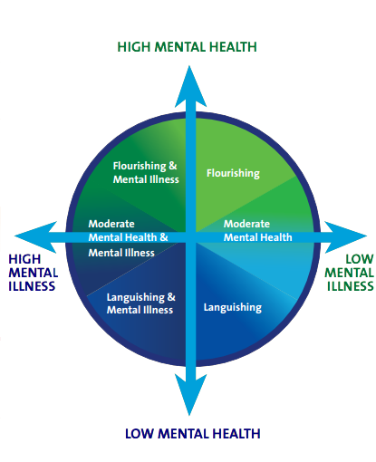
Mental Illness & Mental Health Together
Mental health co-exists with mental illness
Corey Keyes – 2 continua model
6

Slide 5
Career Development
Career development is the lifelong process of managing learning, work, leisure, and transitions in order to move toward a personally determined and evolving preferred future. (S&Gs)
”Work” is only a part of this; “managing” may be the far more important part!
13
Notes:
CDAA Definition, from Cdn Standards & Guidelines: http://www.careerdevelopment.ab.ca/whatiscd
We spend a significant portion of our lives working, and the rest of our waking hours managing how all our other roles fit together to live the life we want!

Slide 6
Career Dev.
Processes
Life Effects
Ability Effects
Self-Perception Effects
Opportunity Effects
Opportunity-Perception Effects
13-15

Slide 7
C.D.
Process
Life Effects
Ability Effects
Self-Perception Effects
Opportunity Effects
Work
Income
Career management skills
Efficacy
Work
Relationships
Identity
Hope
Learning
Social Identity
Opportunity-Perception Effects
Uncertainty Tolerance
Cognitive Bandwidth
Self management skills
16
Notes:
These are how one’s life is changed
Could include pattern, routine

Slide 8
C.D.
Process
Direct Effects
Ability Effects
Self-Perception Effects
Opportunity Effects
Work
Income
Career management skills
Efficacy
Work
Relationships
Identity
Hope
Learning
Social Identity
Opportunity-Perception Effects
Uncertainty Tolerance
Cognitive Bandwidth
Self management skills
Attention
16
Notes:
We’ve discussed mental health in relationship to direct outcomes via Warr’s “vitamins”
What may be more important are the competencies we help clients/students acquire in the process
Here’s Canada’s set of career development competencies – from the Blueprint for Life/Work Designs
Personal Management
Maintain a positive self-image
Build positive relationships
Change and grow throughout life
Learning and Work Exploration
Participate in life-long learning supportive of life/work goals
Locate and use life/work information
Understand the relationship between work and society/economy
Life/Work Building
Secure/create and maintain work
Make life/work enhancing decisions
Maintain balanced life and work roles
Understand the changing nature of life/work roles
Understand, engage in and manage one’s own life/work building process
Emphasize that this is what career development practitioners work on; more so than “getting a job”
Together, these competencies form a realistic basis for ”career self-efficacy”
Also, as these develop, some “outcome” effects start to be created – re: purpose, contribution and connection

Slide 9
C.D.
Process
Direct Effects
Ability Effects
Self-Perception Effects
Opportunity Effects
Work
Income
Career management skills
Efficacy
Work
Relationships
Identity
Hope
Learning
Social Identity
Opportunity-Perception Effects
Uncertainty Tolerance
Cognitive Bandwidth
Self management skills
Attention
Work volition
17
Notes:
Self-Efficacy
I can do this!
Hope
I see possibilities to reach my goals.
Identity
I know who I am.
Mention Amundson & Niles – hope can be a starting point
Might be one of the reasons that co-op programs are so effective re: transitions from post-sec to work
Broaden-and-build theory (Frederickson)
Add “Work Volition” to Self-Perception – agency/ownership/causality

Slide 10
C.D.
Process
Direct Effects
Ability Effects
Self-Perception Effects
Opportunity Effects
Work
Income
Career management skills
Efficacy
Work
Relationships
Identity
Hope
Learning
Social Identity
Opportunity-Perception Effects
Uncertainty Tolerance
Cognitive Bandwidth
Self management skills
Attention
17
Notes:
Freud and ambiguity
Cognitive bandwidth explanation – the more resourceful you are, the more resourceful you can become
“Intention creates attention”
“Purpose” fits with attention

Slide 11
C.D.
Process
Direct Effects
Ability Effects
Self-Perception Effects
Opportunity Effects
Work
Income
Career management skills
Efficacy
Work
Relationships
Identity
Hope
Learning
Social Identity
Opportunity-Perception Effects
Uncertainty Tolerance
Cognitive Bandwidth
Self management skills
Attention
18
Notes:
The world treats you differently when you treat it differently
Birds and coloured markers example

Slide 12
Principles: Integrating Mental Health
Career practitioner’s role in MH/MI support is educational, helping our clients to be aware of the relationship between career and mental health.
Career practitioners are not responsible for assessing or gathering information about our clients’ mental health concerns. But…
For our clients, the client/practitioner relationship is important. Clients with mental health concerns want career practitioners to:
  Respect them as persons, not as diagnoses
  Assure confidentiality
  Maintain focus on career goals, not mental health counselling
23

Slide 13
Career Practitioners Need
Some knowledge of mental health concerns.
Understanding CD/MH connections.
Skills for managing client disclosures.
Skills that maintain boundaries of competence.
Knowledge, understanding, and connection to mental health resources (related resources)
23

Slide 14
Stress
A reaction to perceptions about coping
  Behavioral
  Cognitive
  Physiological
Stress is a reaction to the perception that we might not be able to cope with the demands we are facing.
28

Slide 15
Am I Experiencing Career-Related Stress?
Yes
No
Stressor Management
Stress Management
Reduce Demands
Increase Coping Skills
Manage Stress
21
Adapted from Hiebert, 1987

Slide 16
Career Related Demands
Choosing work
Choosing a major
Understanding self - strengths, needs, values, interests
Work transition
Finding work
Finding meaningful work
Concerns about money
Academic demands
Others’ expectations
Identity concerns
Relationship decisions
29

Slide 17
Mental Health/Illness Concerns Linked to Career Concerns
Depression
Anxiety
Stress
Adjustment Disorders
Substance Use
Concerns with Self-esteem, Self-concept, identity

Slide 18
Career-Related Stress
Concern about coping with career-related demands
Amplified if
  Demand is considered important (e.g., future is contingent on coping)
  Coping is overly challenging (e.g., competitive market)
  Coping is ambiguous - uncertainty about coping

Slide 19
Am I Experiencing Career-Related Stress?
Yes
No
Stressor Management
Stress Management
Reduce Demands
Increase Coping Skills
Manage Stress
21
Adapted from Hiebert, 1987

Slide 20
Reduce Demands
Increase Coping Skills
Manage Stress
Delay Career Decision
Normalize and Validate Career Indecision

Slide 21
Reduce Demands
Increase Coping Skills
Manage Stress
Self-Assessment
Self-Knowledge (NVIS)
Career Research
Online
Experiential
Talking to others
Organizing Information
Career Decision-Making Skills
Experiential Learning
Developmental Perspective
Life-Role Perspective =
Career Planning = Life-Planning

Slide 22
Reduce Demands
Increase Coping Skills
Manage Stress
Body (Physiological)
Mind
(Cognitive)
Behaviour
(Acting As if)

Slide 23
Reduce Demands
Increase Coping Skills
Manage Stress
Normalizing and Validating Indecision
Build Career Development Skills and Knowledge
Stress Management Activities/Skills
Stress Reduction

Slide 24
Reduce Demands
Increase Coping Skills
Manage Stress
Normalizing and Validating Indecision
Build Career Development Skills and Knowledge
Stress Management Activities/Skills
Stress Reduction

Slide 25
Reduce Demands
Increase Coping Skills
Manage Stress
Normalizing and Validating Indecision
Build Career Development Skills and Knowledge
Stress Management Activities/Skills
Stress Reduction
Skill Development
Long-term Coping
Retention
Engagement
Academic Achievement
Self-Esteem
Identity Development

Slide 26
Reduce Demands
Increase Coping Skills
Manage Stress
Normalizing and Validating Indecision
Build Career Development Skills and Knowledge
Stress Management Activities/Skills
Stress Reduction
Stress Reduction
Skill Development
Long-term Coping
Retention
Engagement
Academic Achievement
Self-Esteem
Stress Reduction

Slide 27
Reduce Demands
Increase Coping Skills
Manage Stress
Interventions
Career Decision-Making Skills
Organizing Information
Self-Understanding
Identity Development
Career Research
Experiential Learning
Developmental Perspective
Career Planning = Life-Planning

Slide 28
Am I Experiencing Career Related Stress?
Yes
No
Reduce Demands
Increase Coping Skills
Manage Stress

Slide 29
Outcomes
Stress reduction
Primary prevention (Anxiety, Depression)
Reduced work-related stress (Fit)
Identity and self-understanding
Increased SE, SC, Optimism, Hope
Skill development
Academic achievement (post-secondary?)
Engagement and retention (post-secondary?)
Motivation

Slide 30
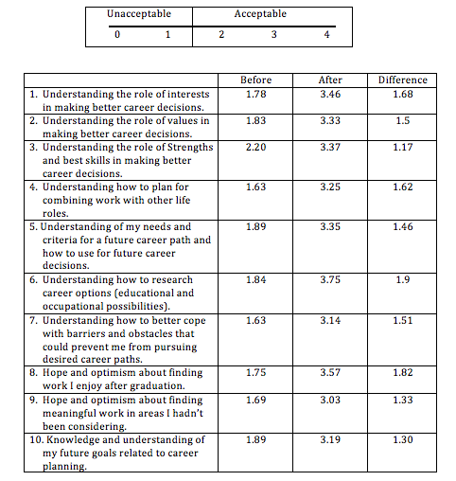
Sample “Post-Pre” Survey Averages from a Career Exploration Workshop
Second highest difference score is on a mental health outcome not addressed in the workshop!
24
Notes:
MH

Slide 31
Stress is Greater If…
Coping is critical
Coping is overly challenging
Coping (how to) is ambiguous or uncertain.
29

Slide 32
Questions and Debrief
In your role as career practitioner, what has been your experience supporting mental health?
What implications does this topic have for your future work as a career development practitioner?

Slide 33

Thank You!
For further information, contact:
Dave Redekopp
📞 780.451.1954
✉️ liferole@telusplanet.net
🖥 www.life-role.com
@liferole
Michael Huston - mwhuston@gmail.com

